Slide 1

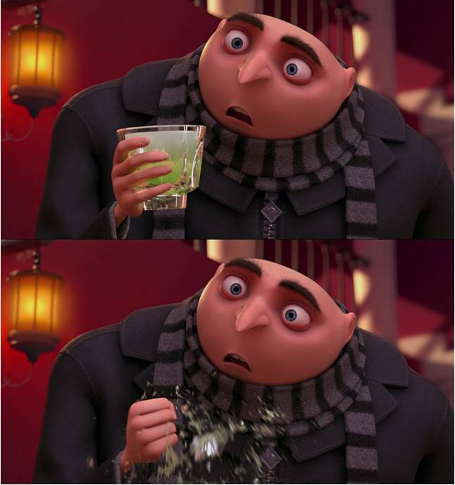
Calculation Session 12
Exercise 6
Created by Heather Barton (‘15)
Revised by Michael Statt (‘16)
Revised by Alex Marzilli (‘17)
Revised by Francis Ledesma & Connie Li (‘19)
Revised by Apoorva Agarwal & Drew Lazarow (‘21)
Revised by Kaleigh Soucy (‘23)
Revised by Donovan Cho (‘25)
Revised by Kong Chen (‘26)
Going through a whole page of math to not get the rate expression because you used the wrong assumption
When two radicals terminate

Slide 2

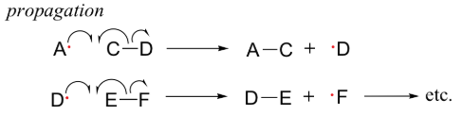

Key Definitions
Initiation: initial creation of radical species (increase in radicals)
Propagation: ‘chain’ part of chain reactions. Once a reactive free radical is generated, it can react with stable molecules to form new free radicals (no change in number of radicals)
Termination: two free radical species react with each other to form a stable non-radical (decrease in radicals)

Slide 3
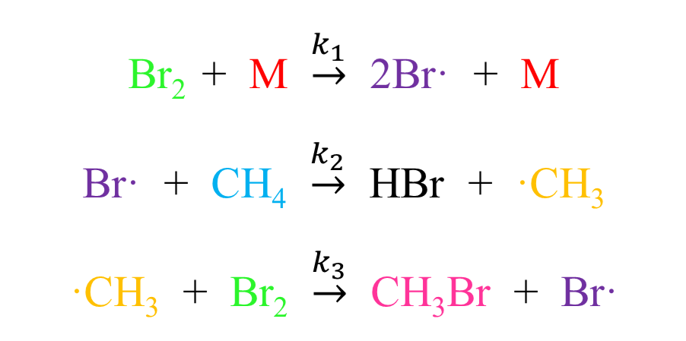
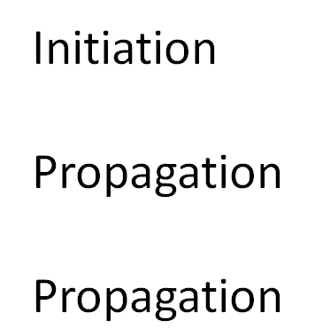
Classify Reaction Steps

Slide 4
Which termination steps are even allowed?

Slide 5

Termination Step #1
Br•
Ternary Collision!
Br₂
M
Allowed?
Possible, but unlikely
Br•

Slide 6
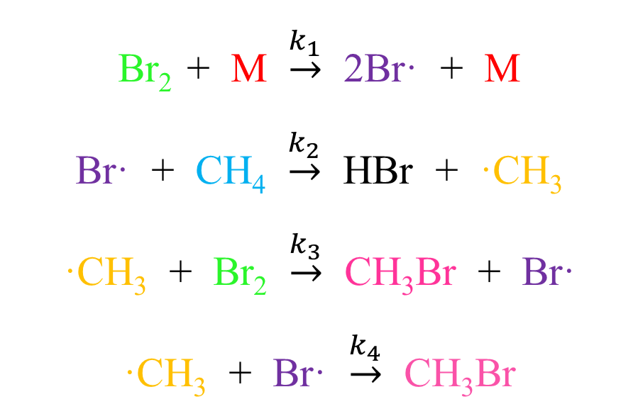

Termination Step #2
Allowed?
No?

Slide 7

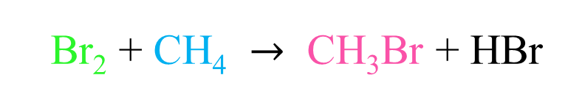
Termination Step #2

Slide 8
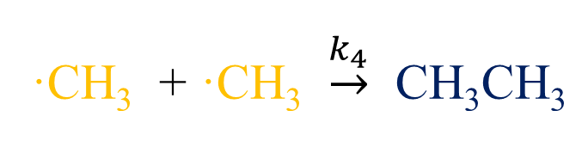
Termination Step #3
CH₃CH₃ is not even an allowed compound!
H
H
C
H
C
H
H
H
Allowed?
YES!

Slide 9
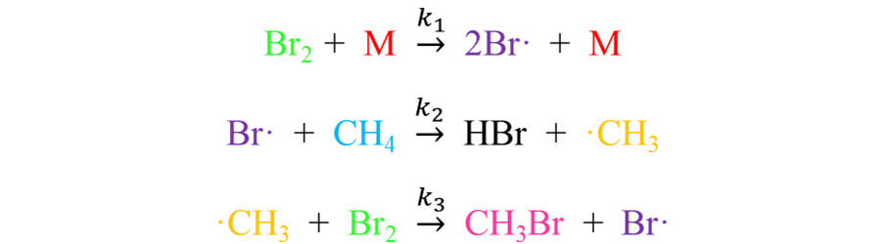
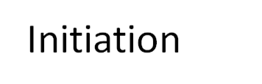
Let’s Solve the Rate Equations
Set rates of propagation equal...

Slide 10

Substitute for [Br•]
Option 1:
Set rate of initiation equal to the rate of termination…
Does this match our original rate equation?

Slide 11
Substitute for [Br•]
Option 2:
Set rate of initiation equal to the rate of termination…
Set rates of propagation equal…
And substitute…

Slide 12
Substitute for [Br•]
Option 2:
Does this match our original rate equation?

Slide 13
Substitute for [Br•]
Option 3:
Does this match our original rate equation?

Slide 14
B.)
For four reactions in series the rate equation is governed by the rate limiting step, A → B:
Rate = k₁[A]
Therefore, the overall E_{a} must be greater than or equal to the E_{a} of the first step.

Slide 15
We have a chain reaction, not a series reaction!
Steps 2, 3, and 4 involve radicals and have a much lower E_{a} than the initiation step and occur many more times.

Slide 16
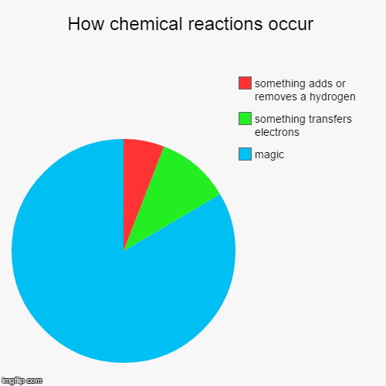
Key Takeaways
Use the propagation reactions as your overall reaction balance
Use the rates of initiation, termination, and propagation to solve for and substitute radicals

