Slide 1
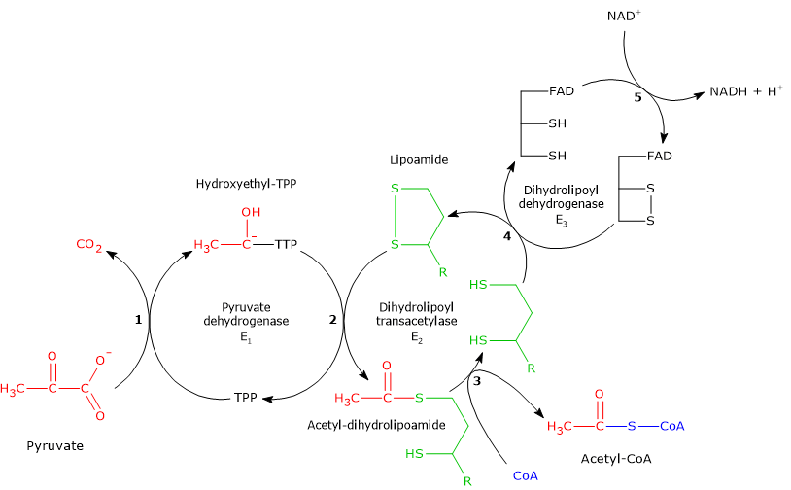
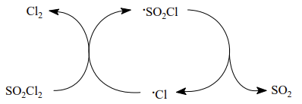
Calculation Section 14
Exercise 4
Created by: Ashlyn Dumaw (‘25)
Edited by: Kong Chen (’26)
Me trying to solve the problem:
The solution:

Slide 2


Slide 3
A) Balancing the Reaction
CH₃OH + HI → CH₃I + H₂O
CH₃I + cis-[Rh(CO₂)I₂]⁻ → [Rh(CH₃)(CO)₂I₃]⁻
[Rh(CH₃)(CO)₂I₃]⁻ + CO → [Rh(CH₃CO)(CO)₂I₃]⁻
[Rh(CH₃CO)(CO)₂I₃]⁻ → cis-[Rh(CO₂)I₂]⁻ + CH₃COI
CH₃COI + H₂O → CH₃COOH + HI

Slide 4
A) Balancing the Reaction
CH₃OH + HI → CH₃I + H₂O
CH₃I + cis-[Rh(CO₂)I₂]⁻ → [Rh(CH₃)(CO)₂I₃]⁻
[Rh(CH₃)(CO)₂I₃]⁻ + CO → [Rh(CH₃CO)(CO)₂I₃]⁻
[Rh(CH₃CO)(CO)₂I₃]⁻ → cis-[Rh(CO₂)I₂]⁻ + CH₃COI
CH₃COI + H₂O → CH₃COOH + HI
CH₃OH + CO → CH₃COOH

Slide 5
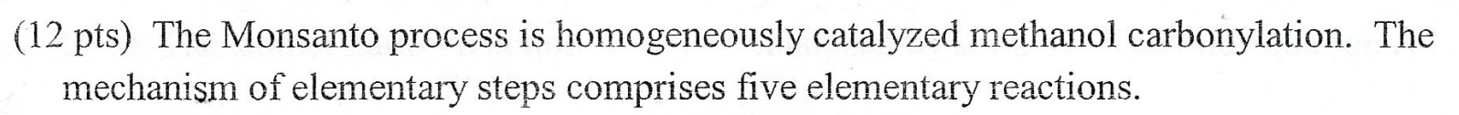

A) Balancing the Reaction
CH₃OH + CO → CH₃COOH

Slide 6
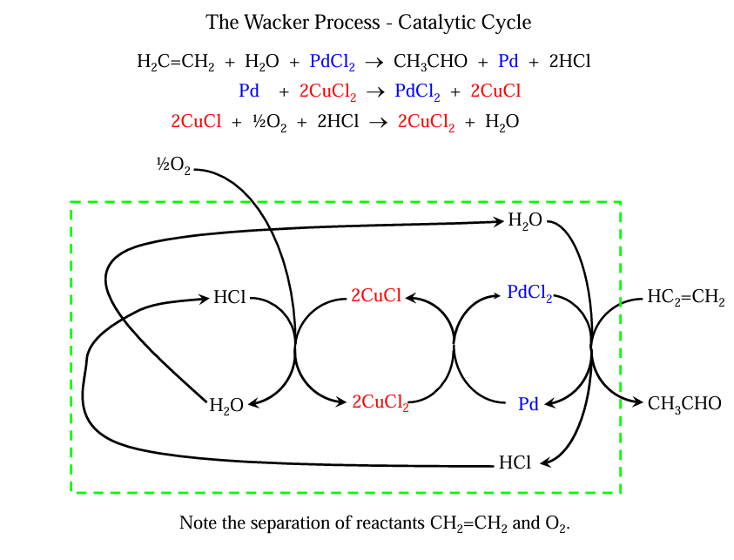
B) Drawing the Cycle: Wacker Process
(Kinetics Lecture 14)
Multiple cycles
Overall reaction shown
Catalysts cycle through
  Similar to radical propagation cycles

Slide 7
B) Drawing the Cycle
CH₃OH + HI → CH₃I + H₂O
CH₃I + cis-[Rh(CO₂)I₂]⁻ → [Rh(CH₃)(CO)₂I₃]⁻
[Rh(CH₃)(CO)₂I₃]⁻ + CO → [Rh(CH₃CO)(CO)₂I₃]⁻
[Rh(CH₃CO)(CO)₂I₃]⁻ → cis-[Rh(CO₂)I₂]⁻ + CH₃COI
CH₃COI + H₂O → CH₃COOH + HI
HI
CH₃OH

Slide 8

B) Drawing the Cycle
CH₃OH + HI → CH₃I + H₂O
CH₃I + cis-[Rh(CO₂)I₂]⁻ → [Rh(CH₃)(CO)₂I₃]⁻
[Rh(CH₃)(CO)₂I₃]⁻ + CO → [Rh(CH₃CO)(CO)₂I₃]⁻
[Rh(CH₃CO)(CO)₂I₃]⁻ → cis-[Rh(CO₂)I₂]⁻ + CH₃COI
CH₃COI + H₂O → CH₃COOH + HI
cis-[Rh(CO₂)I₂]⁻
Overall species on the outside
CH₃OH
CH₃I
[Rh(CH₃)(CO)₂I₃]⁻
HI
H₂O

Slide 9
B) Drawing the Cycle
CH₃OH + HI → CH₃I + H₂O
CH₃I + cis-[Rh(CO₂)I₂]⁻ → [Rh(CH₃)(CO)₂I₃]⁻
[Rh(CH₃)(CO)₂I₃]⁻ + CO → [Rh(CH₃CO)(CO)₂I₃]⁻
[Rh(CH₃CO)(CO)₂I₃]⁻ → cis-[Rh(CO₂)I₂]⁻ + CH₃COI
CH₃COI + H₂O → CH₃COOH + HI
CH₃OH
CH₃I
[Rh(CH₃)(CO)₂I₃]⁻
CO
HI
H₂O
cis-[Rh(CO₂)I₂]⁻
CH₃COOH
[Rh(CH₃CO)(CO)₂I₃]⁻
CH₃COI

Slide 10
B) Drawing the Cycle
CH₃OH + HI → CH₃I + H₂O
CH₃I + cis-[Rh(CO₂)I₂]⁻ → [Rh(CH₃)(CO)₂I₃]⁻
[Rh(CH₃)(CO)₂I₃]⁻ + CO → [Rh(CH₃CO)(CO)₂I₃]⁻
[Rh(CH₃CO)(CO)₂I₃]⁻ → cis-[Rh(CO₂)I₂]⁻ + CH₃COI
CH₃COI + H₂O → CH₃COOH + HI
CH₃OH
CH₃I
[Rh(CH₃)(CO)₂I₃]⁻
CO
HI
H₂O
cis-[Rh(CO₂)I₂]⁻
CH₃COOH
CH₃COI
[Rh(CH₃CO)(CO)₂I₃]⁻
Method 1: tracing the cycles
.. Easy to get lost

Slide 11
B) Drawing the Cycle
CH₃OH + HI → CH₃I + H₂O
CH₃I + cis-[Rh(CO₂)I₂]⁻ → [Rh(CH₃)(CO)₂I₃]⁻
[Rh(CH₃)(CO)₂I₃]⁻ + CO → [Rh(CH₃CO)(CO)₂I₃]⁻
[Rh(CH₃CO)(CO)₂I₃]⁻ → cis-[Rh(CO₂)I₂]⁻ + CH₃COI
CH₃COI + H₂O → CH₃COOH + HI
CH₃OH + HI → CH₃I + H₂O
CH₃COI + H₂O → CH₃COOH + HI
CH₃OH + CH₃COI → CH₃I + CH₃COOH
CH₃OH
CH₃I
HI
H₂O
CH₃COOH
CH₃COI

Slide 12
B) Drawing the Cycle
CH₃OH + HI → CH₃I + H₂O
CH₃I + cis-[Rh(CO₂)I₂]⁻ → [Rh(CH₃)(CO)₂I₃]⁻
[Rh(CH₃)(CO)₂I₃]⁻ + CO → [Rh(CH₃CO)(CO)₂I₃]⁻
[Rh(CH₃CO)(CO)₂I₃]⁻ → cis-[Rh(CO₂)I₂]⁻ + CH₃COI
CH₃COI + H₂O → CH₃COOH + HI
CH₃I + cis-[Rh(CO₂)I₂]⁻ → [Rh(CH₃)(CO)₂I₃]⁻
[Rh(CH₃)(CO)₂I₃]⁻ + CO → [Rh(CH₃CO)(CO)₂I₃]⁻
[Rh(CH₃CO)(CO)₂I₃]⁻ → cis-[Rh(CO₂)I₂]⁻ + CH₃COI
CH₃I + CO → CH₃COI
CH₃I
[Rh(CH₃)(CO)₂I₃]⁻
CO
cis-[Rh(CO₂)I₂]⁻
CH₃COI
[Rh(CH₃CO)(CO)₂I₃]⁻

Slide 13
B) Drawing the Cycle
CH₃OH + HI → CH₃I + H₂O
CH₃I + cis-[Rh(CO₂)I₂]⁻ → [Rh(CH₃)(CO)₂I₃]⁻
[Rh(CH₃)(CO)₂I₃]⁻ + CO → [Rh(CH₃CO)(CO)₂I₃]⁻
[Rh(CH₃CO)(CO)₂I₃]⁻ → cis-[Rh(CO₂)I₂]⁻ + CH₃COI
CH₃COI + H₂O → CH₃COOH + HI
CH₃OH
CH₃I
CH₃I
[Rh(CH₃)(CO)₂I₃]⁻
CO
HI
H₂O
cis-[Rh(CO₂)I₂]⁻
CH₃COOH
CH₃COI
CH₃COI
[Rh(CH₃CO)(CO)₂I₃]⁻

Slide 14
B) Drawing the Cycle
CH₃OH + HI → CH₃I + H₂O
CH₃I + cis-[Rh(CO₂)I₂]⁻ → [Rh(CH₃)(CO)₂I₃]⁻
[Rh(CH₃)(CO)₂I₃]⁻ + CO → [Rh(CH₃CO)(CO)₂I₃]⁻
[Rh(CH₃CO)(CO)₂I₃]⁻ → cis-[Rh(CO₂)I₂]⁻ + CH₃COI
CH₃COI + H₂O → CH₃COOH + HI
CH₃OH
CH₃I
[Rh(CH₃)(CO)₂I₃]⁻
CO
HI
H₂O
cis-[Rh(CO₂)I₂]⁻
CH₃COOH
CH₃COI
[Rh(CH₃CO)(CO)₂I₃]⁻
Method 2: identifying cycles

Slide 15
Key Takeaways
Balance a catalytic mechanism like any other reaction
To draw a catalytic cycle, you can:
  Follow reactant(s) through the cycle
  Identify different cycles and then combine
Helpful hints
  Position overall species on the outside
  Put species that “cycle” in the middle
You can always redraw!

