Slide 1
Calculation Session 14
Exercise 5
T. M. Duncan

Slide 2
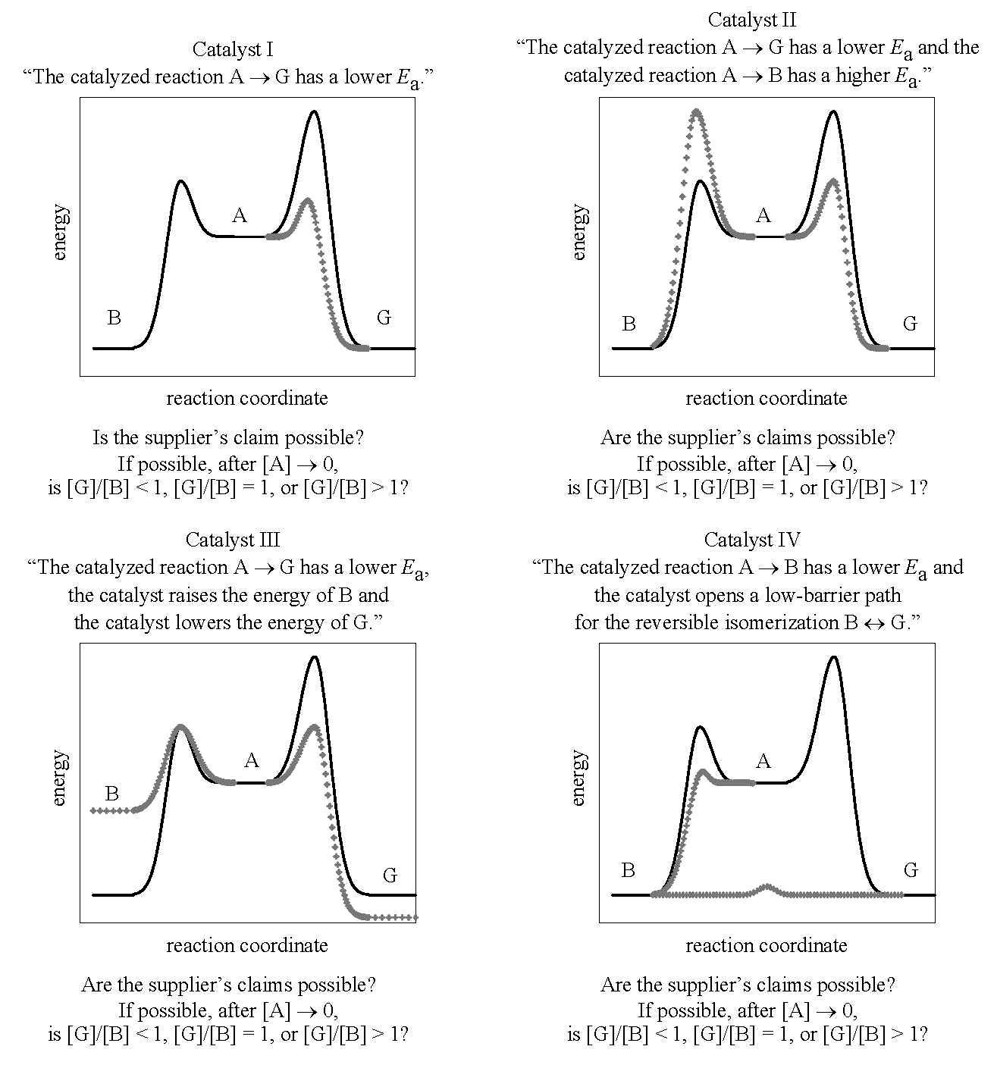

yes
yes
no
yes

