Slide 1
Calculation Session 14 Exercise 6
Created by Doug Greer ’12
Revised by Allan Brooks ’14
Revised by Bill Wheatle ’15
Revised by Eric McShane ’16
Revised by Apoorva Agarwal & Drew Lazarow ’21
Revised by Ariel Struzyk ‘23
Revised by Lauren de Silva ’25
Revised by Emily Destito ’26

Slide 2
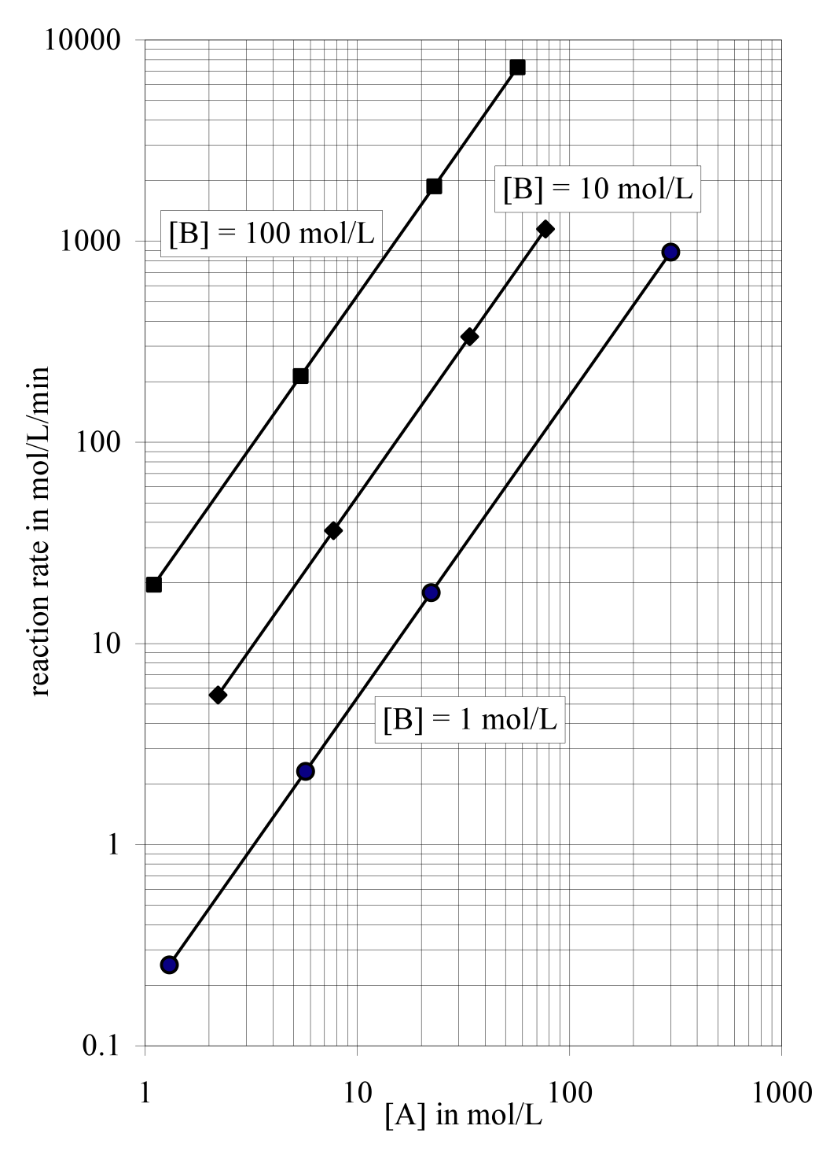
A + 2B → C + D
The rate of the irreversible reaction A + 2B → C + D
is measured at various concentrations of A and B.
For each line on the graph below, [B] was at the
same concentration, as indicated by the labels.
Determine the:
reaction order with respect to A
reaction order with respect to B
rate constant k

Slide 3


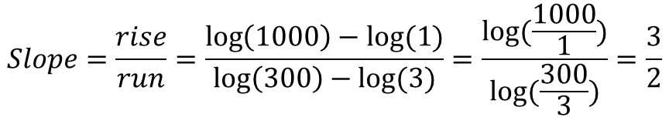
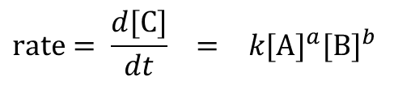
Order for A?
$$rate= \frac{d[C]}{dt} = k[A]^{a}[B]^{b}$$
[B]=1
$$\log\left(rate\right)=logK+alog\left[A\right]+blog[B]$$
Rate increases from
1 → 1000
LOG LOG PLOT!!
$$Slope=\frac{rise}{run}=\frac{\log\left(1000\right)−log⁡(1)}{\log\left(300\right)−log⁡(3)}=\frac{log⁡(\frac{1000}{1})}{log⁡(\frac{300}{3})}=\frac{3}{2}$$
A increases from
3 → 300
a = 3/2
Notes:
Why no C or D dependence?
If I instead measured 13/8, should I report that as the order wrt A?

Slide 4
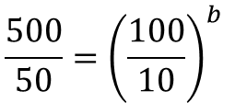
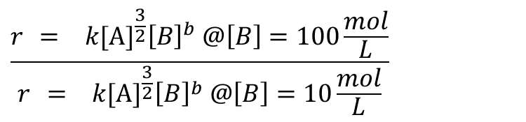
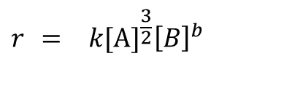
Order for B?
$$r = k[A]^{\frac{3}{2}}{\left[B\right]}^{b}$$
Let’s keep A constant to isolate [B]^{b}
500
$$\frac{r = k[A]^{\frac{3}{2}}{\left[B\right]}^{b} @\left[B\right]=100\frac{mol}{L}}{r = k[A]^{\frac{3}{2}}{\left[B\right]}^{b} @\left[B\right]=10\frac{mol}{L}}$$
50
$$\frac{500}{50}={\left(\frac{100}{10}\right)}^{b}$$
10-fold increase in [B] gives 10-fold increase in rate
b=1

Slide 5
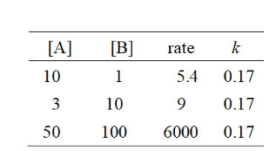



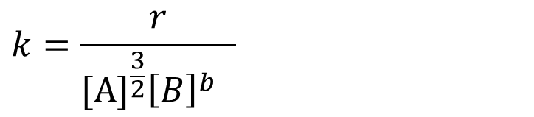
Now find k:
6000
$$k=\frac{r}{[A]^{\frac{3}{2}}{\left[B\right]}^{b} }$$
9
5.4
k = 0.17

Slide 6
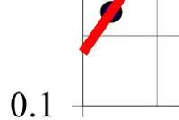
Now find k but more clever:
Any point will work, but…
We have a line where [B]=1 and a point where [A]=1
k is between 0.1 and 0.2
5 cm 4 cm
➔
5 cm = log(0.2) – log(0.1)
k = 0.17
4 cm = log(k) – log(0.1)

Slide 7

Units?
M/s = k * M ^{3/2} * M
k = 0.17 M^{-3/2} s⁻¹

Slide 8
Takeaways
Remember how to use a log-log plot.
Don’t forget rate order & kinetics even though we’re focusing on mechanisms in class.
Remember units!
Know how to interpret graphical & numerical data.

