Slide 1
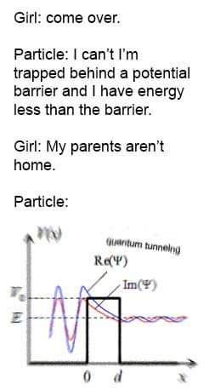
Calculation Session 14: Exercise 8
Created By Lauren Taylor ’14
Revised by Heather Barton (’15), Will Gregg (’16), Max Graham & Sarah Paquin (’21), Kaleigh Soucy (’23), Dennis Wu (’25), Lara Capellino (’26)

Slide 2
What are we given?
A
A
A
R
R
M
M
M
M
M
M
M
M
M
M

Slide 3




How do we interpret these graphs?
A
A
A
A
M
M
M
M
M

Slide 4
A) Identify on the graph the equilibrium bond distance for an adsorbed A atom.

Slide 5
B) Identify on the graph the equilibrium bond distance for an adsorbed A₂ molecule.

Slide 6
C) What is the adsorption energy of A? That is, what is the reaction energy for M + A → M-A?
M + A
M-A

Slide 7
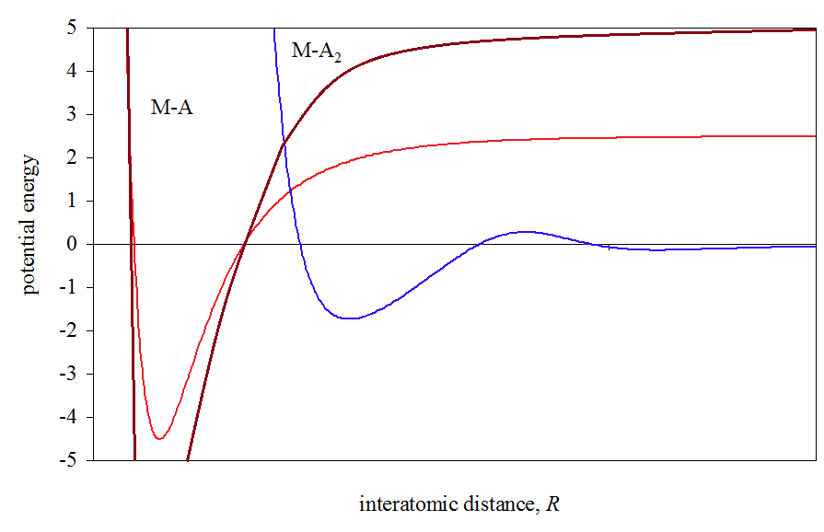
D) What is the bond energy of an A₂ molecule?
This is the same as finding the energy between A₂ → 2A, we want to sketch the curve for 2A

Slide 8
E) What is the activation energy for the adsorption of A₂?
Activation energy between M + A₂ → M- A₂
M + A
M-A

Slide 9
F) What is the activation energy for the adsorption of an A atom?
Activation energy for the reaction M + A → M-A?
E_{a}=0
M + A
M-A

Slide 10
G) What is the activation energy for the conversion of adsorbed A₂ to adsorbed A?
Activation energy for the reaction M-A₂ + M → M-A + M-A ?
M + A
M-A

Slide 11
H) Does A₂ adsorb associatively or dissociatively?
M + A₂ → M-A₂
2M + A₂ → M-A + M-A

Slide 12
H) Does A₂ adsorb associatively or dissociatively?
M + A₂ → M-A₂
2M + A₂ → M-A + M-A
larger
smaller
N₂ + Fe
Fe-N≡N
Associatively!
Example:
N₂ + Fe → Fe-N≡N (equilibrium)
Fe-N≡N + Fe → Fe-N + Fe-N (RLS)
Fe-N + Fe-N

Slide 13
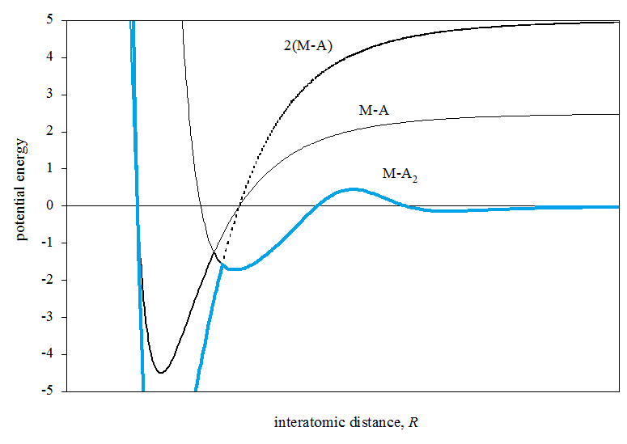
I) If you decided A₂ adsorbs associatively, sketch potentials for dissociative adsorption, vice versa
Dissociative:
H₂ + 2Fe
Need lower activation energy at the intersection point!
Example:
H₂ + 2Fe → Fe-H + Fe-H (fast)
Fe-H + Fe-H

Slide 14
Key Takeaways
Equilibrium bond distance is at the minimum of the potential energy curve
Adsorption energy of an atom A is the vertical distance between the lowest vibrational level of M-A and the energy of an A atom far from the surface
Look at activation energy to determine the type of adsorption!

