Slide 1
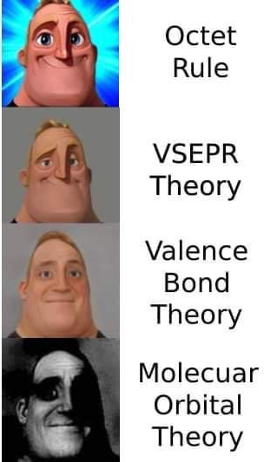
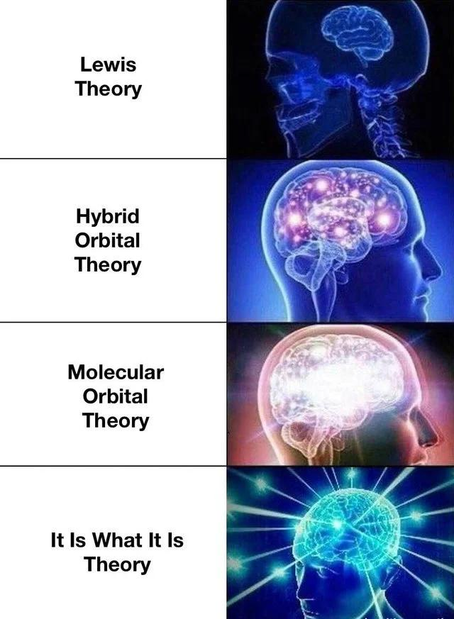
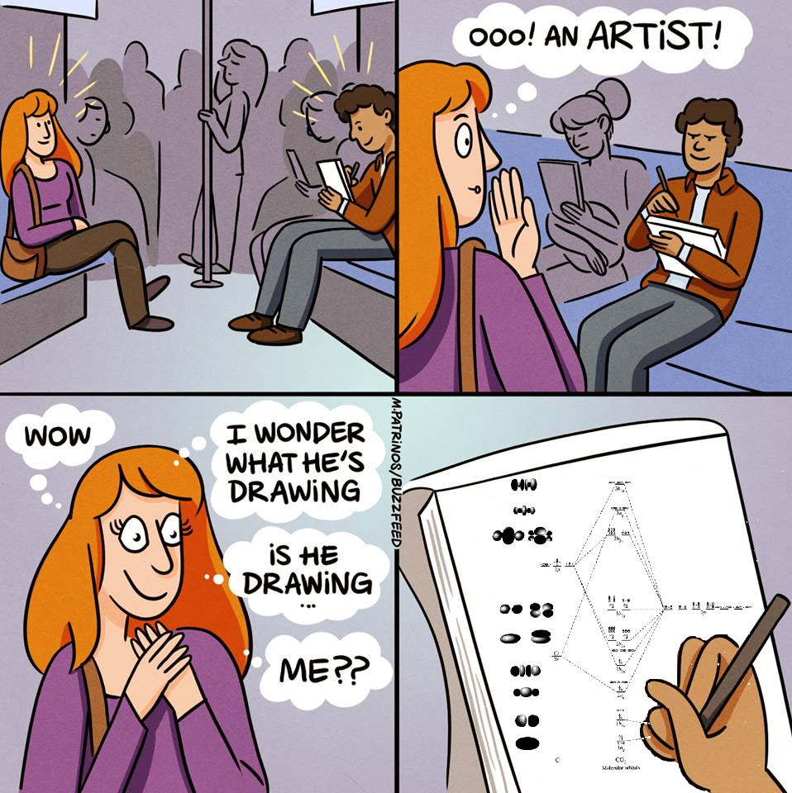
Calculation Session 2 Exercise 1
Created by Kaleigh Soucy (‘23)
Edited by Ashlyn Dumaw (‘25)
Amy Wu (‘26)

Slide 2

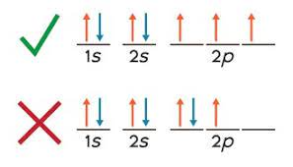

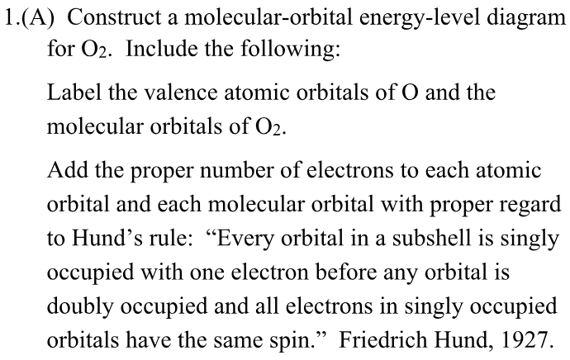
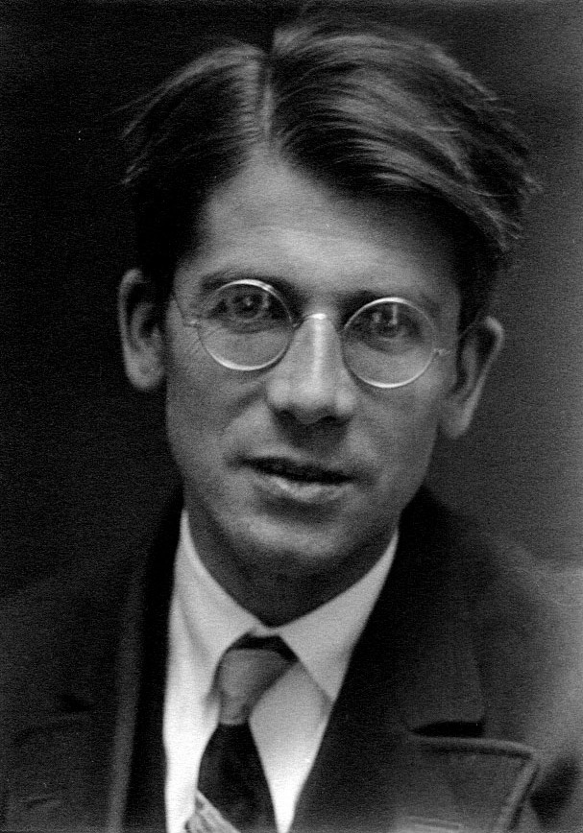
I’m back!!!
Hund:

Slide 3
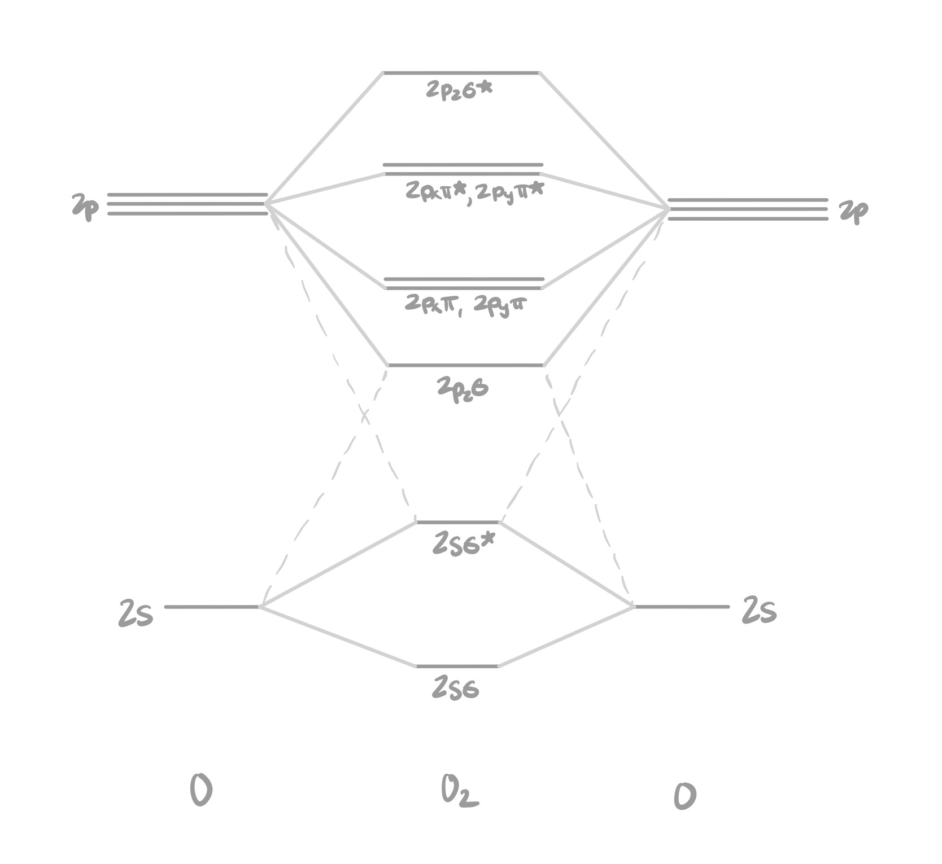

Oxygen
Valence orbitals: 2s and 2p
6 valence electrons
Optional
O2 and F2: 2pzσ has lower energy than 2pxπ, 2pyπ
2pzσ*
2p
2pxπ*, 2pyπ*
2p
2pxπ, 2pyπ
2pzσ
2sσ*
2s
2s
2sσ

Slide 4
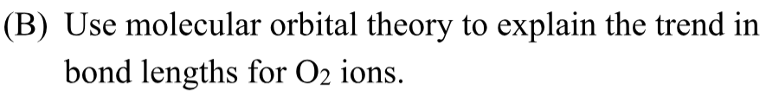

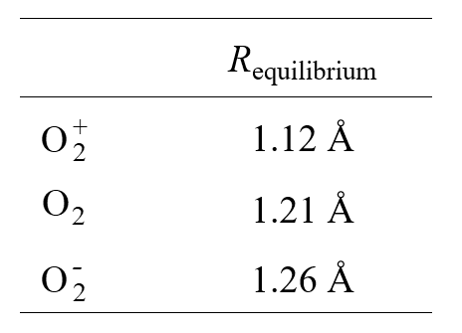
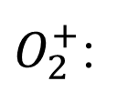

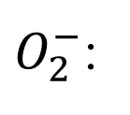

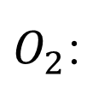

2pzσ*
2p
2pxπ*, 2pyπ*
2p
2pxπ, 2pyπ
2pzσ
σ and π
σ* and π*
2sσ*
bond order = $\frac{1}{2}(bonding e^{−}−antibonding e^{−})$
2s
2s
$O_{2}$:
$\frac{1}{2}\left(8−4\right)$ = 2
2sσ
$O_{2}^{−}$:
$\frac{1}{2}\left(8−5\right)$ = 1.5
$O_{2}^{+}$:
$\frac{1}{2}\left(8−3\right)$ = 2.5

Slide 5

Bond order/strength is inversely proportional to bond length
bond order
2.5
2
1.5
Increasing bond length
Decreasing bond order

Slide 6


Key Takeaways
Molecular orbitals are filled from bottom to top
Hund’s rule applies to both molecular and atomic orbitals
Bond order and bond length are inversely related

