Slide 1
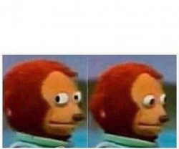
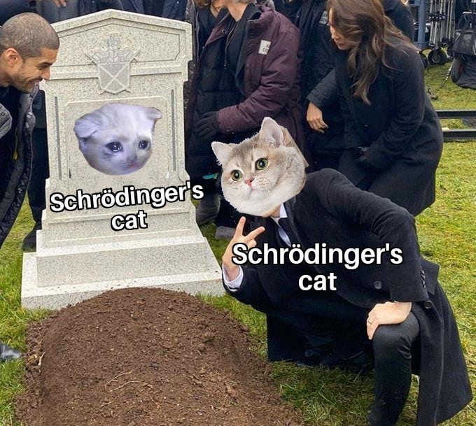

Calculation Session 2
Exercise 5
Leon Lee (‘23)
Lauren de Silva (‘25)
Edited by: Kong Chen (‘26)
*Me trying to figure out if the TA planted an error in the presentation*
Professor: “This should be a review”

Slide 2
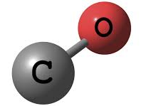
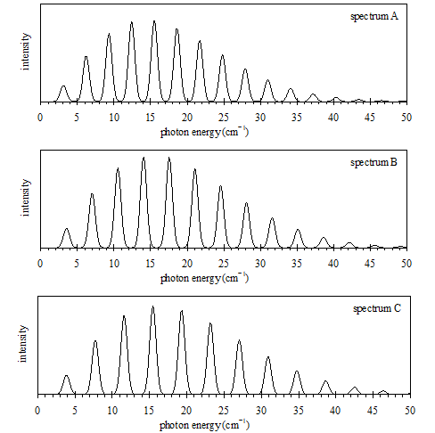


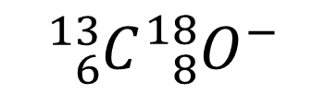
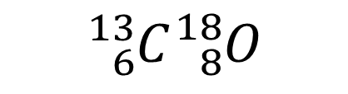
Match…
$${}_{6}^{12}{C{}_{8}^{16}O}$$
with
$${}_{6}^{13}{C{}_{8}^{18}O}$$
$${}_{6}^{13}{C{}_{8}^{18}{O^{−}}}$$

Slide 3
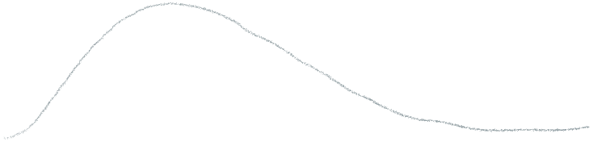
What information can we extract from the spectrum?
2B
Rotational constant
Microwave region, B~ 0.1-10 cm⁻¹ ➔rotational transitions
The shape of envelop➔ temperature insight
Let’s compare the distance between peaks of emitted photons!

Slide 4
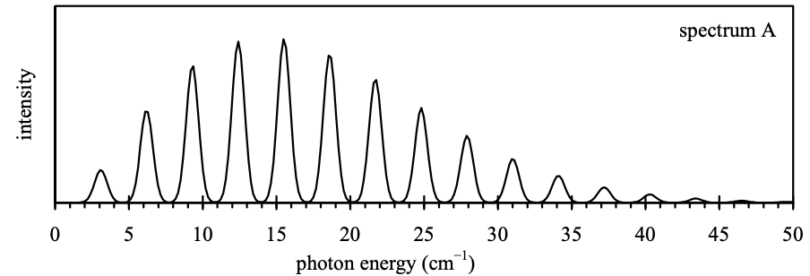
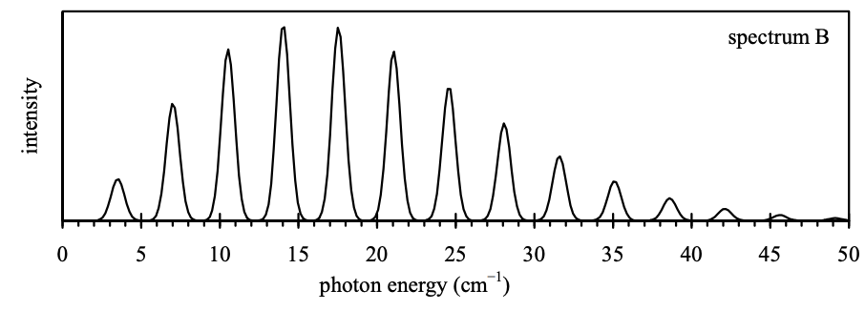
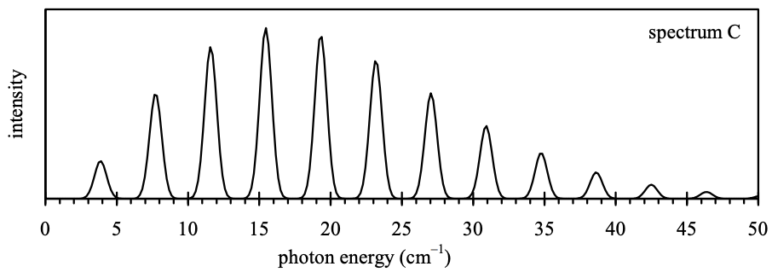
A
B
Spectrum A: B~ 1.0cm⁻¹
Spectrum B: B~ 1.75cm⁻¹
Spectrum C: B~ 2.25cm⁻¹
B_{A}<B_{B}<B_{c}
C

Slide 5
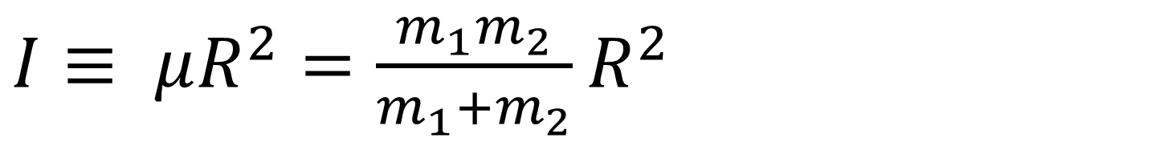

The Rotational “Constant” B
“Pre-factor” because B is not a constant. B changes with different molecular properties
$$B≡\frac{ℏ}{4 πc I}$$
Moment of inertia contains important molecular information
$I≡ μR^{2}=\frac{m_{1}m_{2}}{m_{1}{+m}_{2}}$ $R^{2}$
Diatomic radius
Reduced mass
molecular weight of carbon
molecular weight of oxygen

Slide 6
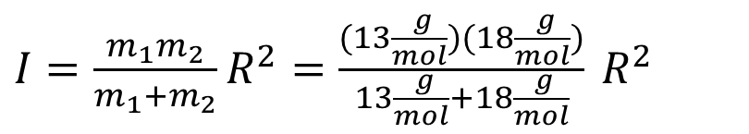
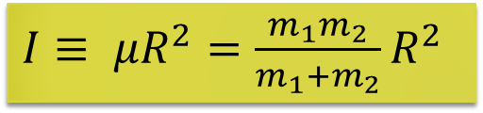


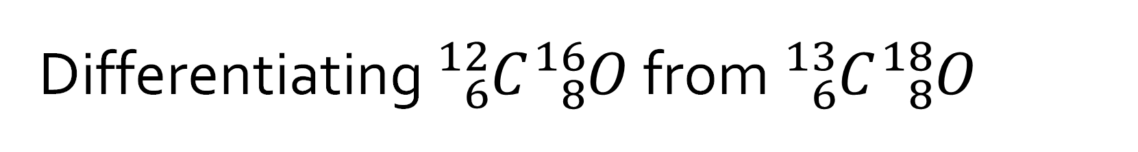

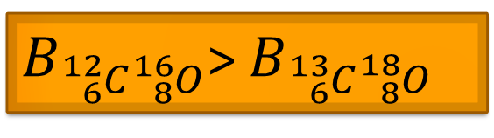
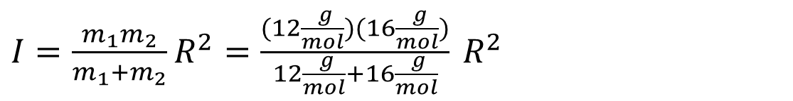


Differentiating ${}_{6}^{12}C{}_{8}^{16}O$ from ${}_{6}^{13}C{}_{8}^{18}O$
$I≡ μR^{2}=\frac{m_{1}m_{2}}{m_{1}{+m}_{2}}$ $R^{2}$
$${}_{6}^{12}C{}_{8}^{16}O$$
$${}_{6}^{13}C{}_{8}^{18}O$$
$I=\frac{m_{1}m_{2}}{m_{1}{+m}_{2}}$ $R^{2}=\frac{(12\frac{ g}{mol})(16\frac{ g}{mol})}{12\frac{ g}{mol}+16\frac{ g}{mol}} R^{2}$
$I=\frac{m_{1}m_{2}}{m_{1}{+m}_{2}}$ $R^{2}=\frac{(13\frac{ g}{mol})(18\frac{ g}{mol})}{13\frac{ g}{mol}+18\frac{ g}{mol}} R^{2}$
<
$$I_{{}_{6}^{12}C{}_{8}^{16}O}=6.86R^{2}$$
$$I_{{}_{6}^{13}C{}_{8}^{18}O}=7.55R^{2}$$
$$B≡\frac{ℏ}{4 πc I}$$
Since $B∝I^{−1}$
$B_{{}_{6}^{12}C{}_{8}^{16}O}$> $B_{{}_{6}^{13}C{}_{8}^{18}O}$

Slide 7

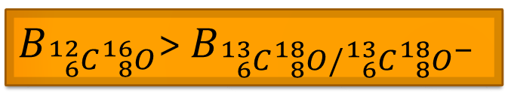
Our Options
$B_{{}_{6}^{12}C{}_{8}^{16}O}$> $B_{{}_{6}^{13}C{}_{8}^{18}O/{}_{6}^{13}C{}_{8}^{18}{O^{−}}}$
Increasing B
$${}_{6}^{12}C{}_{8}^{16}O$$

Slide 8
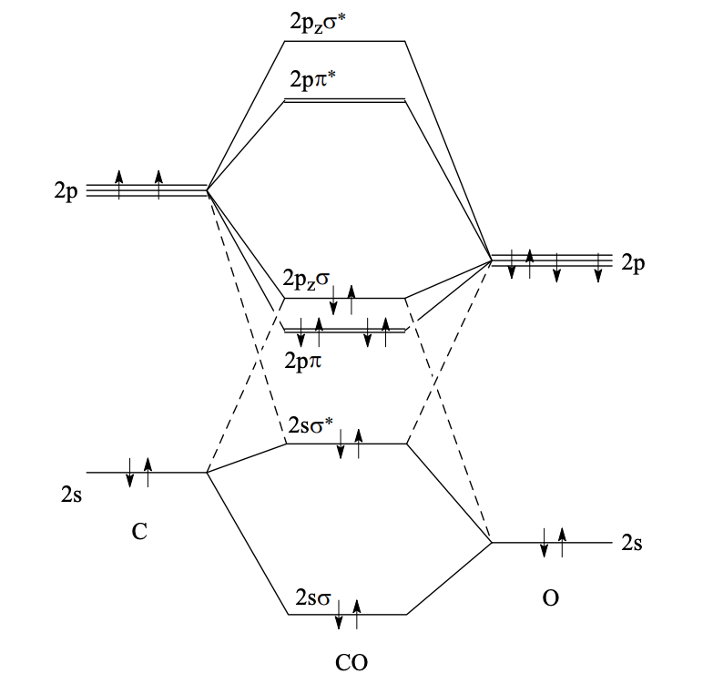


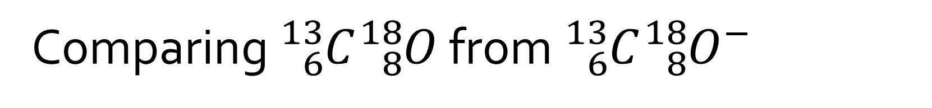
Comparing ${}_{6}^{13}C{}_{8}^{18}O$ from ${}_{6}^{13}C{}_{8}^{18}{O^{−}}$
We cannot use reduced mass to differentiate as only an electron was added
So what else can we use?
Hint from the question→Molecular Orbital Theory🤑
How can we relate MO theory to bond length?
Recall Exercise 1

Slide 9
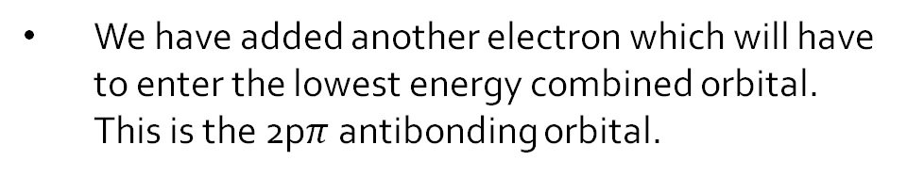
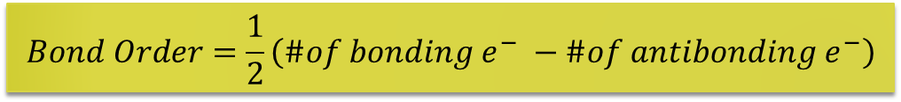
MO Theory of Carbon Monoxide
Bond order, an effective length of bonds, can be calculated by the following formula:
$$Bond Order=\frac{1}{2}\left(\#of {bonding e}^{−} −\#of antibonding e^{−}\right)$$
We have added another electron which will have to enter the lowest energy combined orbital. This is the 2p$π$ antibonding orbital.

Slide 10

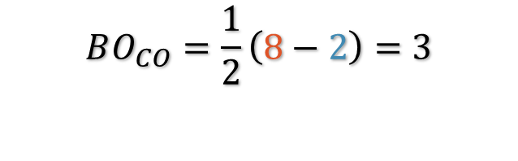
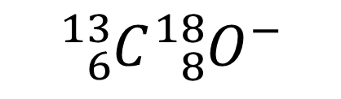
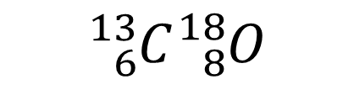
Bond Order Calculation
$${}_{6}^{13}{C{}_{8}^{18}O}$$
$${}_{6}^{13}C{}_{8}^{18}{O^{−}}$$
$$BO_{CO}=\frac{1}{2}\left(8−2\right)=3$$
$$BO_{CO^{−}}=\frac{1}{2}\left(8−3\right)=2.5$$

Slide 11

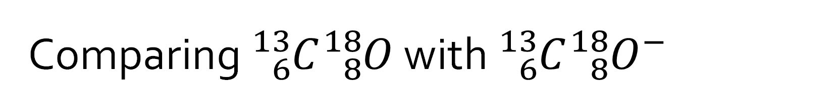
Comparing ${}_{6}^{13}C{}_{8}^{18}O$ with ${}_{6}^{13}C{}_{8}^{18}{O^{−}}$
Bond order gives us information about relative bond strength
Stronger bonds → Shorter bond length → Smaller diatomic radius
BO_{CO} > BO_{CO}⁻
R_{CO} < R_{CO}⁻
$$I≡ μR^{2}$$
I_{CO} < I_{CO}⁻
B_{CO} > B_{CO}⁻

Slide 12



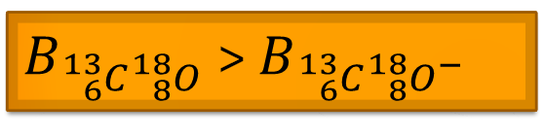
Our Options
$${}_{6}^{13}C{}_{8}^{18}{O^{−}}$$
$B_{{}_{6}^{13}C{}_{8}^{18}O}$> $B_{{}_{6}^{13}C{}_{8}^{18}{O^{−}}}$
Increasing B
$${}_{6}^{13}C{}_{8}^{18}O$$
$${}_{6}^{12}C{}_{8}^{16}O$$

Slide 13
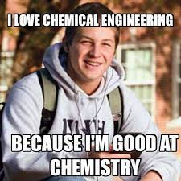
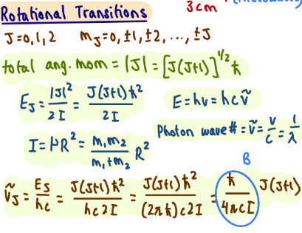
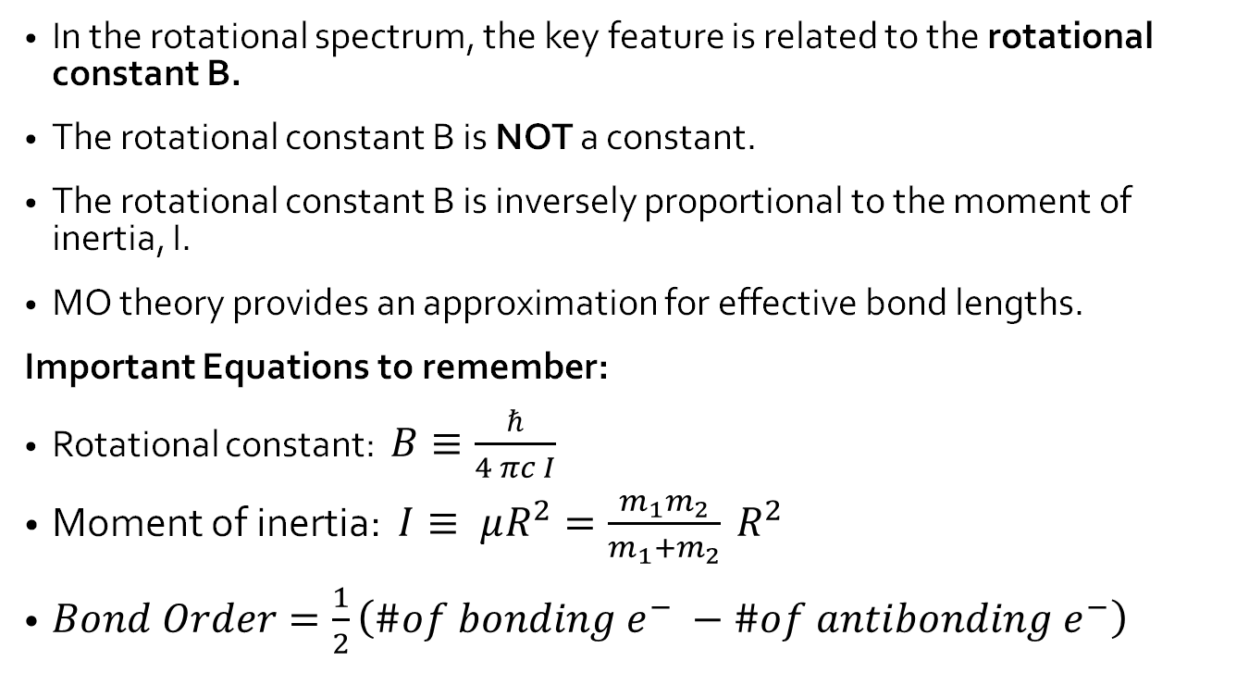
Key Takeaways
In the rotational spectrum, the key feature is related to the rotational constant B.
The rotational constant B is NOT a constant.
The rotational constant B is inversely proportional to the moment of inertia, I.
MO theory provides an approximation for effective bond lengths.
Important Equations to remember:
Rotational constant: $B≡\frac{ℏ}{4 πc I}$
Moment of inertia: $I≡ μR^{2}=\frac{m_{1}m_{2}}{m_{1}{+m}_{2}} R^{2}$
$Bond Order=\frac{1}{2}\left(\#of {bonding e}^{−} −\#of antibonding e^{−}\right)$

