Slide 1
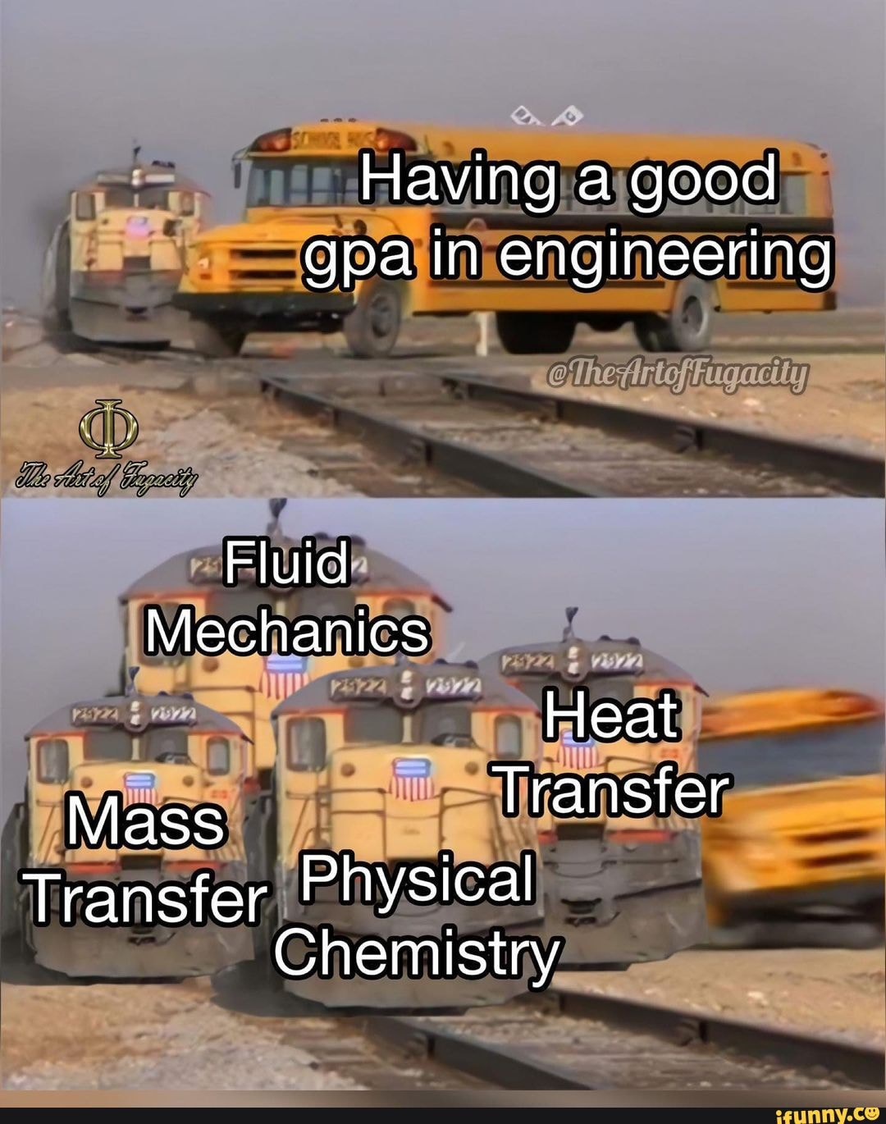
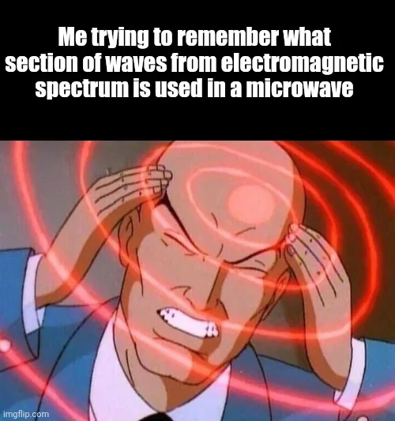
Calculation Session 3:
Exercise 2
Created by Brianna Morris (‘23)
Edited by Ashlyn Dumaw and Dennis Wu (‘25), Lara Capellino (‘26)

Slide 2
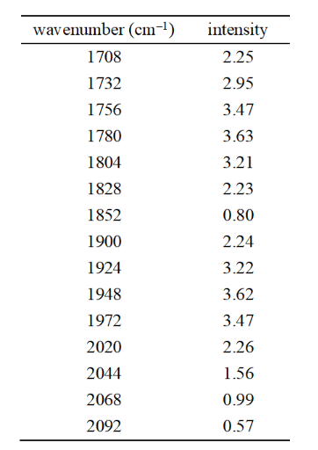
Task:
Find the frequency and intensity of the lost peak
Find the temperature of the distant object
First: What type of spectrum is this?
Always take time to identify the information provided!
Exactly! This is a vibrational-rotational spectrum. By problem statement: an emission spectrum.
But how do we know?

Slide 3
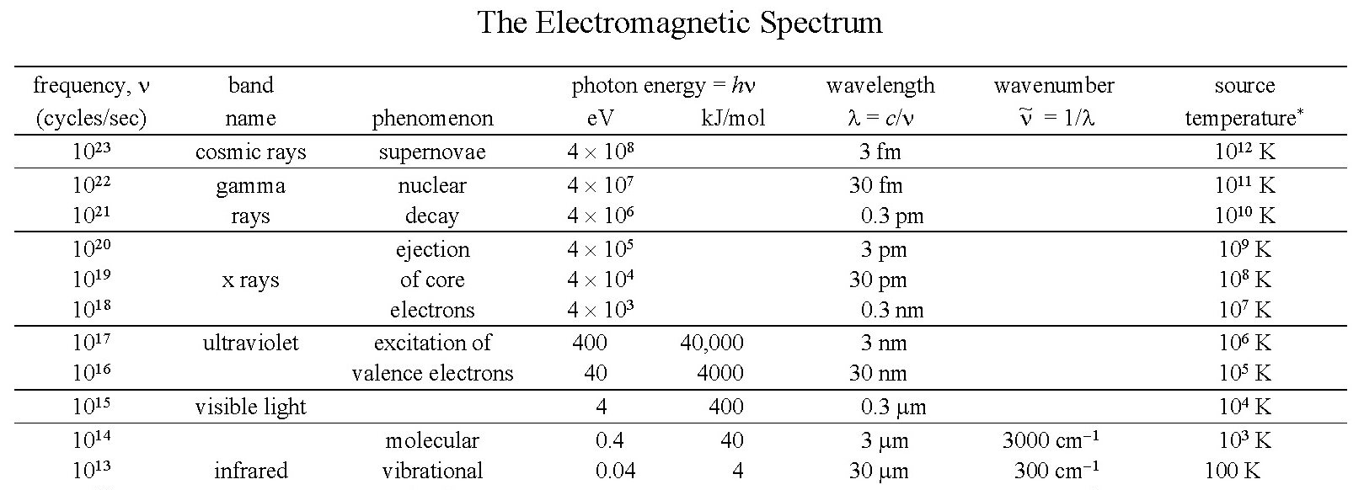
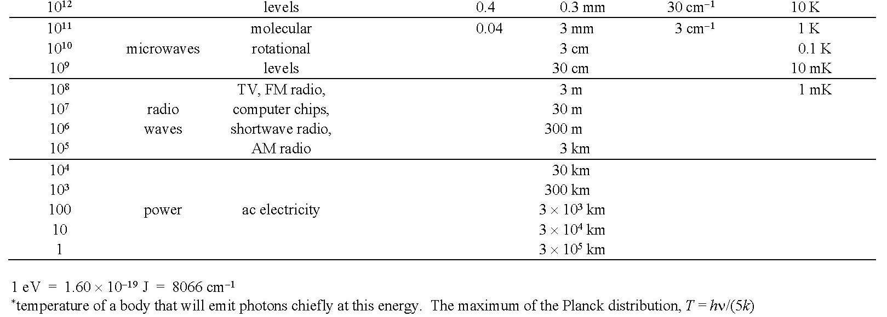
How do we know what type of spectrum?
Easiest way is to look at the wavenumber range
Provides information about observed phenomenon!

Slide 4
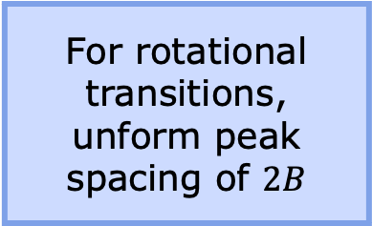


A) Frequency of the peak lost in transmission
For rovibrational spectra: peak spacing is key information
Remember!!
For rotational transitions, unform peak spacing of $2B$
+24
+24
$$2B=24 {cm}^{−1}$$
+24
+24
+24
+24
$$B=12 {cm}^{−1}$$
+48
+24
+24
+24
+48
+24
+24
+24

Slide 5

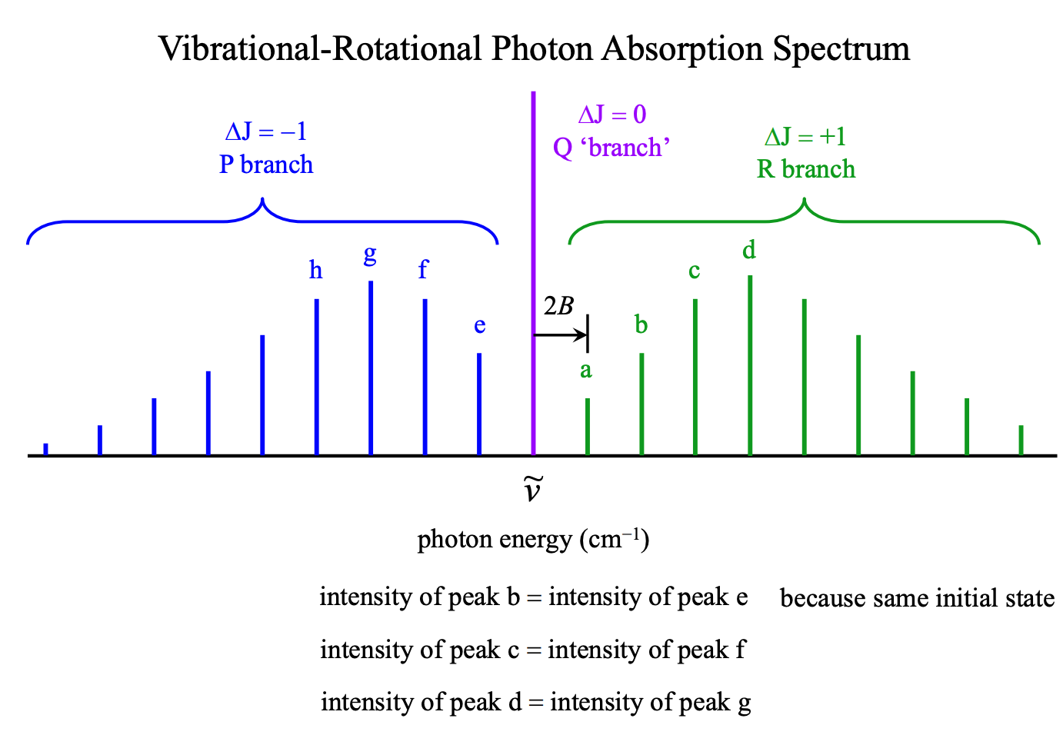


A) Frequency of the peak lost in transmission
BUT WAIT!!!!!!!
Uniform distribution around the Q branch
It is possible that this diatomic does not have a Q (ΔJ = 0) branch.
1876${cm}^{−1}$
1$996 {cm}^{−1}$

Slide 6
B) Intensity of the lost peak
From Part (A): frequency of the lost peak is 1996 cm⁻¹
Represents the J = 5’ to 6
transition
P branch
By symmetry about the missing Q branch, lost peak intensity must be around 2.95
Q branch
1996 cm⁻¹
R branch
Represents the J = 5’ to 4 transition
Remember: uniform distribution around the Q branch

Slide 7
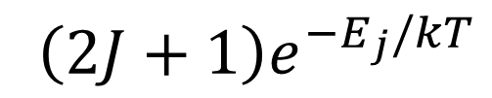

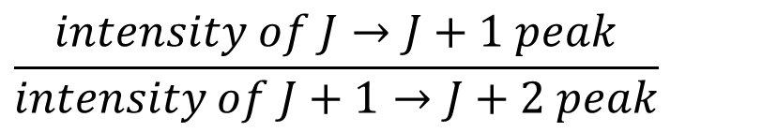
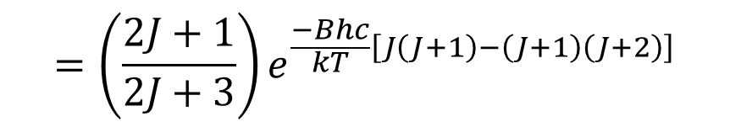
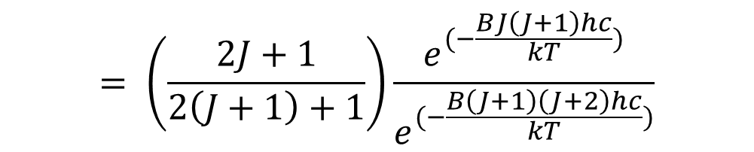
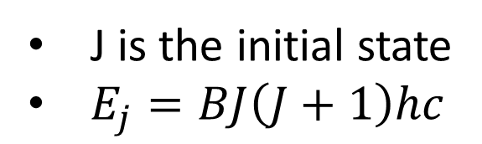
C) Temperature of Distant Object
Intensity of a rotational transition is proportional to
$\left(2J+1\right)e^{−E_{j}/kT}$
J is the initial state
$E_{j}=BJ\left(J+1\right)hc$
Find the general equation for the ratio of intensities between two peaks
$$= \left(\frac{2J+1}{2\left(J+1\right)+1}\right)\frac{e^{(−\frac{BJ\left(J+1\right)hc}{kT})}}{e^{(−\frac{B\left(J+1\right)\left(J+2\right)hc}{kT})}}$$
$$\frac{intensity of J→J+1 peak}{intensity of J+1→J+2 peak}$$
$$=\left(\frac{2J+1}{2J+3}\right)e^{\frac{−Bhc}{kT}\left[J\left(J+1\right)−\left(J+1\right)\left(J+2\right)\right]}$$
$$=\left(\frac{2J+1}{2J+3}\right)e^{\frac{2Bhc}{kT}(J+1)}$$

Slide 8
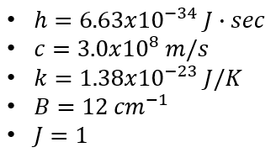
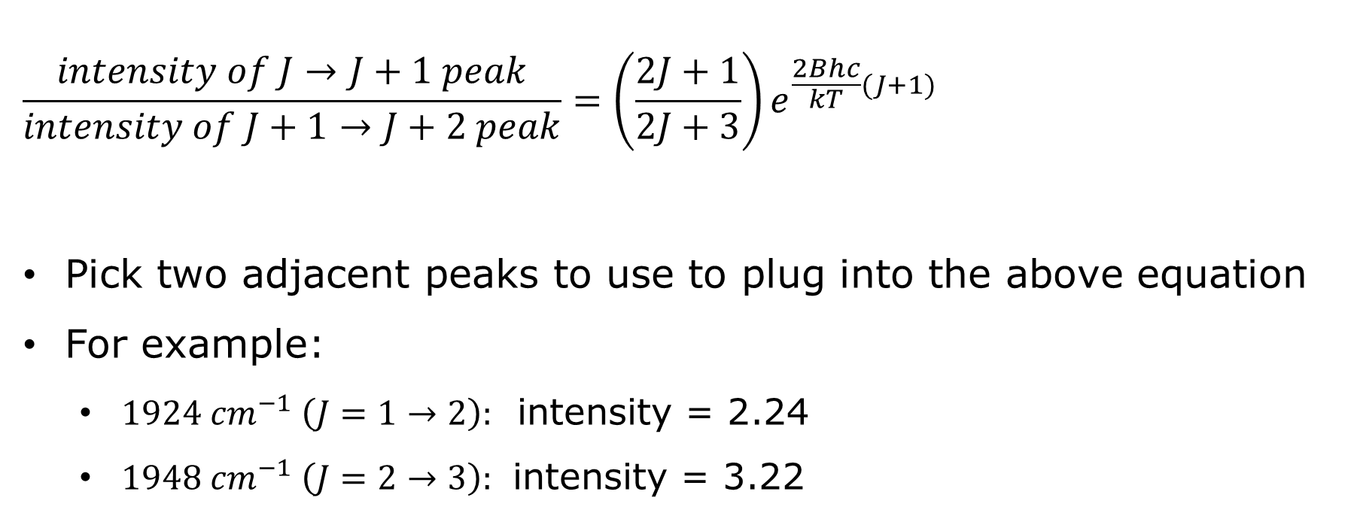
C) Temperature of Distant Object
$$\frac{intensity of J→J+1 peak}{intensity of J+1→J+2 peak}=\left(\frac{2J+1}{2J+3}\right)e^{\frac{2Bhc}{kT}(J+1)}$$
Pick two adjacent peaks to use to plug into the above equation
For example:
  $1924 {cm}^{−1} \left(J=1→2\right):$ intensity = 2.24
  $1948 {cm}^{−1} \left(J=2→3\right):$ intensity = 3.22

Slide 9
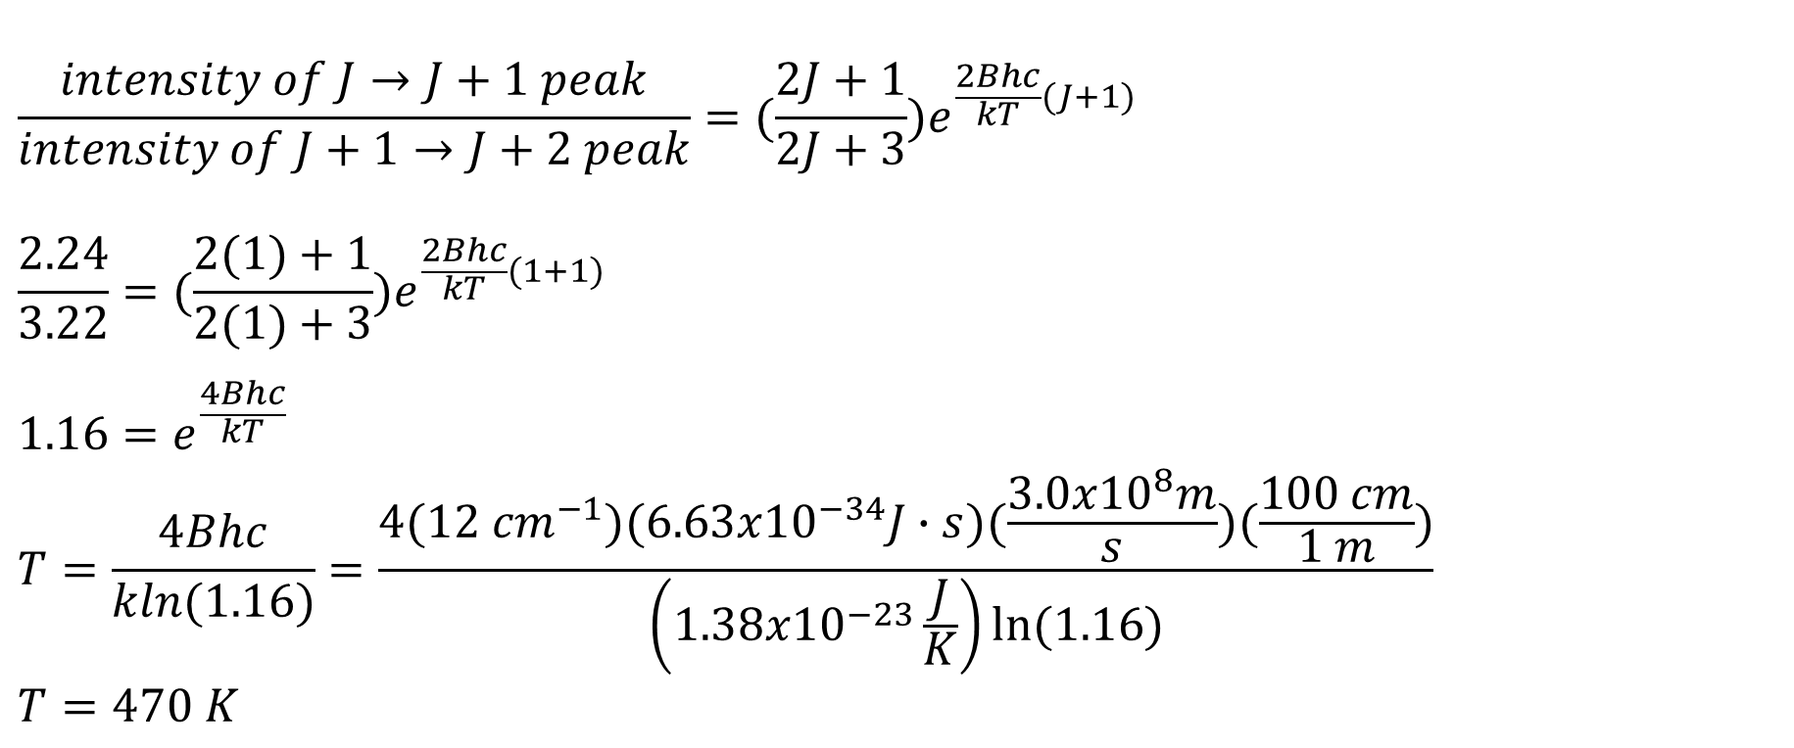
C) Temperature of Distant Object
$$\frac{intensity of J→J+1 peak}{intensity of J+1→J+2 peak}=(\frac{2J+1}{2J+3})e^{\frac{2Bhc}{kT}(J+1)}$$
$$\frac{2.24}{3.22}=(\frac{2(1)+1}{2(1)+3})e^{\frac{2Bhc}{kT}(1+1)}$$
$$1.16=e^{\frac{4Bhc}{kT}}$$
$$T=\frac{4Bhc}{kln(1.16)}=\frac{4(12 {cm}^{−1})(6.63x{10}^{−34}J∙s)(\frac{3.0x{10}^{8}m}{s})(\frac{100 cm}{1 m})}{\left(1.38x{10}^{−23}\frac{J}{K}\right)ln⁡(1.16)}$$
$$T=470 K$$
Note: You might get slightly different numbers depending on what peaks you chose due to uncertainty in the measured intensities. Should be around 500 K.

Slide 10
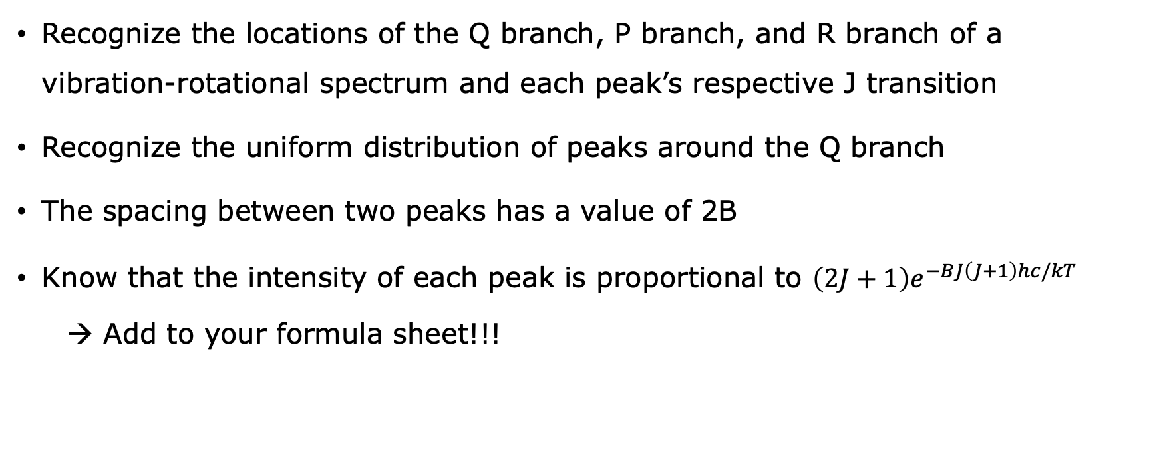
Main Takeaways
Recognize the locations of the Q branch, P branch, and R branch of a vibration-rotational spectrum and each peak’s respective J transition
Recognize the uniform distribution of peaks around the Q branch
The spacing between two peaks has a value of 2B
Know that the intensity of each peak is proportional to $\left(2J+1\right)e^{−BJ\left(J+1\right)hc/kT}$
  → Add to your formula sheet!!!

