Slide 1
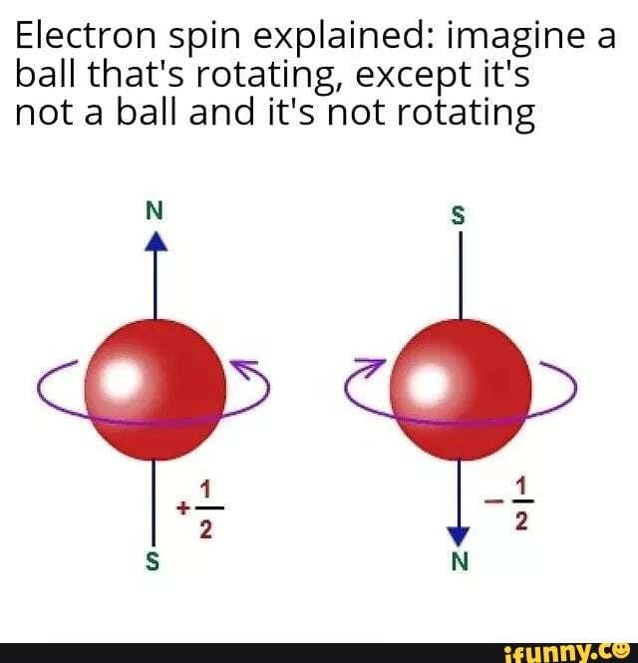


Calculation Session 3
Exercise 4
Created by Brianna Morris (‘23)
Edited by Lauren de Silva and Donovan Cho (‘25)
Edited by Vivian Liu (‘26)

Slide 2
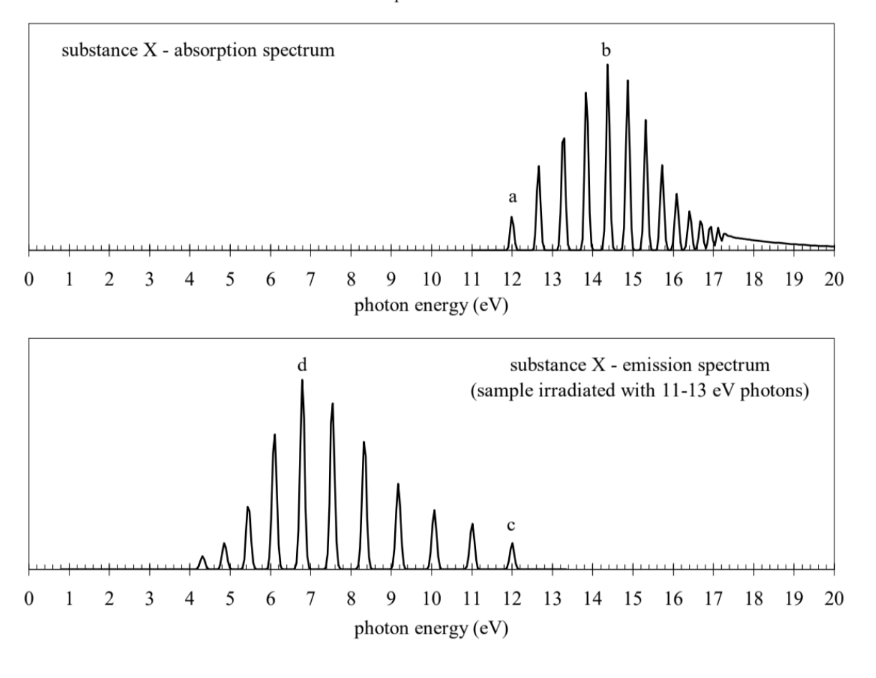


What do we have?
UV absorption and emission spectra of gaseous substance X, a diatomic molecule
The sample of X is at a high pressure

Slide 3

What do we need to find?
Which peaks in the emissions and absorption spectrums correspond to which transitions
Dissociation energy of X in its electronic ground state and first electronic excited state
Molecular potential energy curves of the ground and first excited electronic states

Slide 4

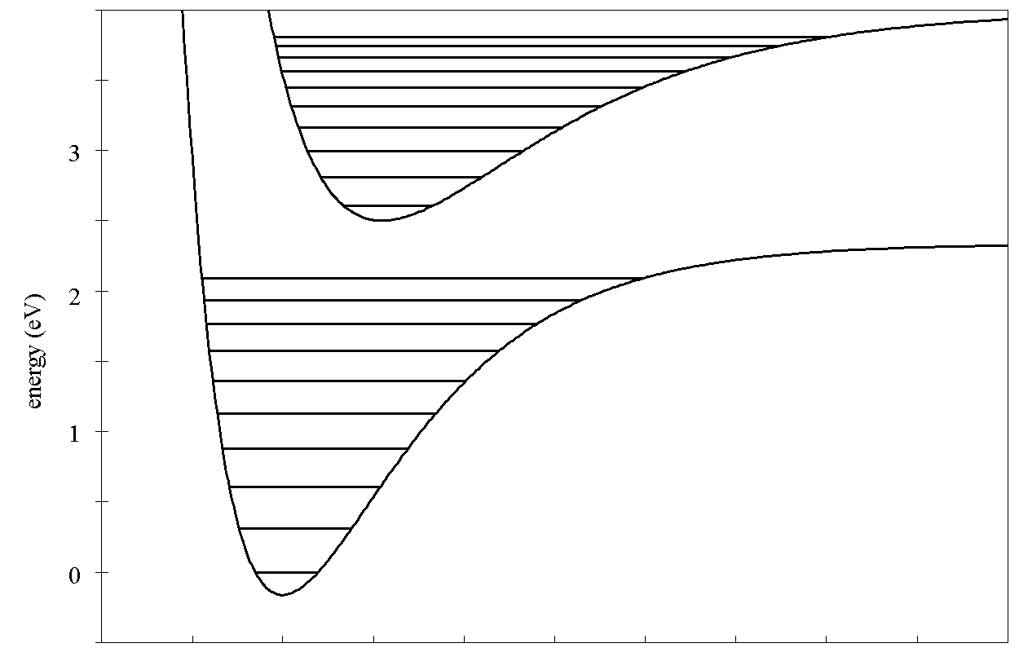
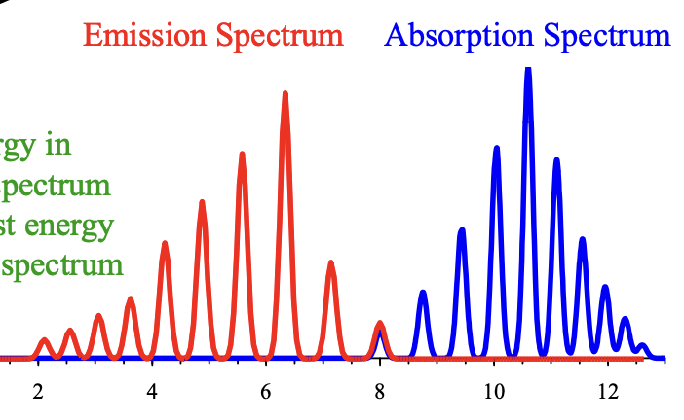
What is absorption/emission?
First excited electronic state
v ‘= 3
v ‘= 2
v ‘= 1
v ‘= 0
Ground electronic state
v’ = 0 to v = 2
v = 0 to v’ = 2
v = 2
v’ = 0 to v = 1
v = 1
v = 0 to v’ = 1
v = 0
v = 0 to v’ = 0
v’ = 0 to v = 0

Slide 5

(A) Vibrational levels of the initial and final states – Absorption spectrum
The gas molecules will start in the lowest vibrational state, v = 0
Peak a represents the lowest energy absorption peak
v’ = 4
v’ = 3
v’ = 2
v’ = 1
v’ = 0
peak a: v = 0 to v’ = 0
peak b: v = 0 to v’ = 4

Slide 6

(A) Vibrational levels of the initial and final states – Emission spectrum
The gas molecules will relax to the v’ = 0 state after being excited electronically
Sample is at high pressure! Collisions transfer kinetic energy → Photon emission
Peak c represents the highest energy peak (overlaps with emission spectra)
v = 6
v = 5
v = 4
v = 3
v = 2
v = 1
v = 0
peak c: v’ = 0 to v = 0
peak b: v’ = 0 to v = 6

Slide 7

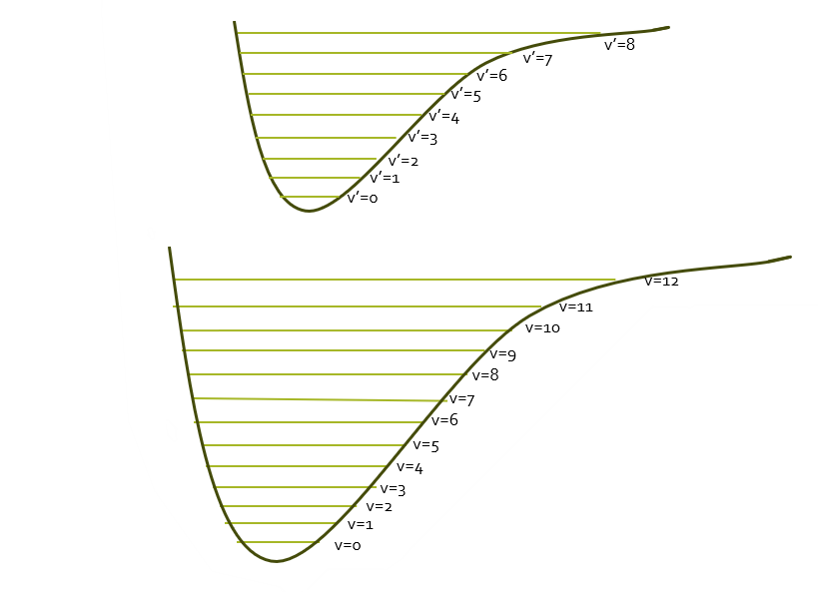
(B) Dissociation energy of X in its electronic ground state
v=0
v=12
D_{e}
D_{e} = 17.3 eV – 12 eV = 5.3 eV
Notes:
Note: This is the misleading slide for joint presentation script
Incorrect drawing of the energy levels. Ground state should have 8 vibrational levels and the excited state should have 12
Should use the emissions spectrum not absorption

Slide 8
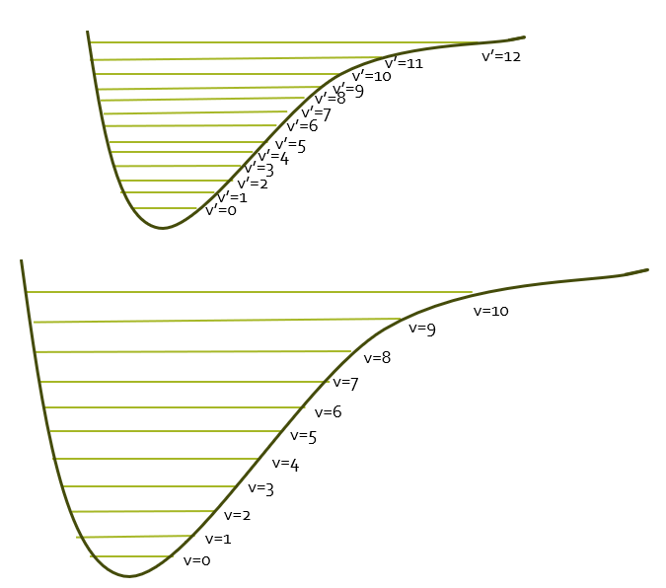

(B) Dissociation energy of X in its electronic ground state
4.2 eV
12 eV
D_{e}
D_{e} = 12eV – 4.2eV = 7.8eV
Notes:
Identify the error:
- Peaks represent transitions between excited states, they do not give us information about the vibration transitions within the same energy state

Slide 9


(C) Dissociation energy of X in its first electronic excited state
D_{e}
12 eV
17.3 eV
D_{e} = 17.3 eV – 12 eV = 5.3 eV

Slide 10

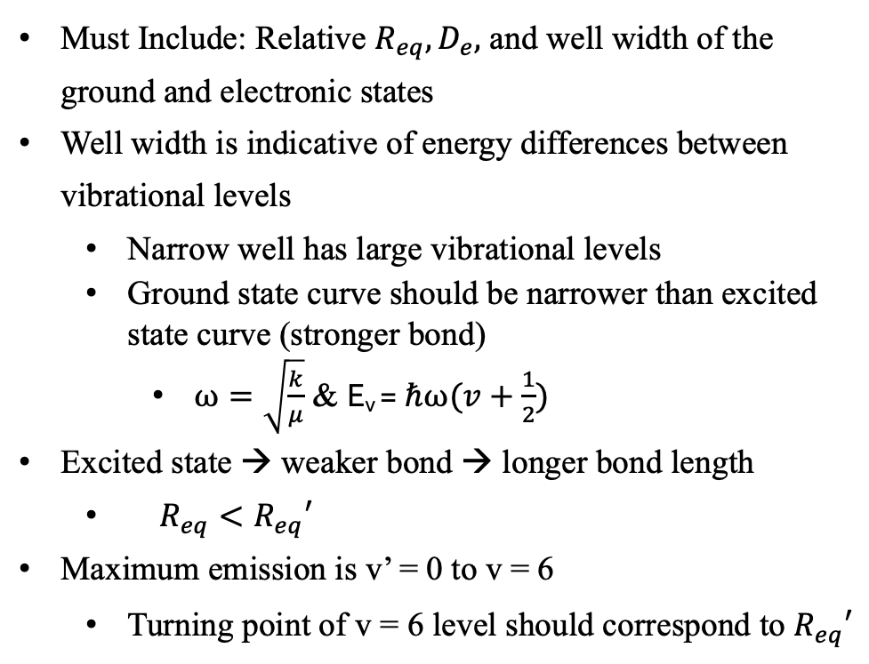
(D) Sketching molecular potential curves
Must Include: Relative $R_{eq}, D_{e},$ and well width of the ground and electronic states
Well width is indicative of energy differences between vibrational levels
  Narrow well has large vibrational levels
  Ground state curve should be narrower than excited state curve (stronger bond)
    $ω=\sqrt{\frac{k}{μ}}$ & E_{v} ​=$ℏω(v+\frac{1}{2})$
Excited state → weaker bond → longer bond length
  $R_{eq}<R_{eq}′$
Maximum emission is v’ = 0 to v = 6
  Turning point of v = 6 level should correspond to $R_{eq}′$
Excited State
Ground State
Notes:
Need to cut the text on this page

Slide 11



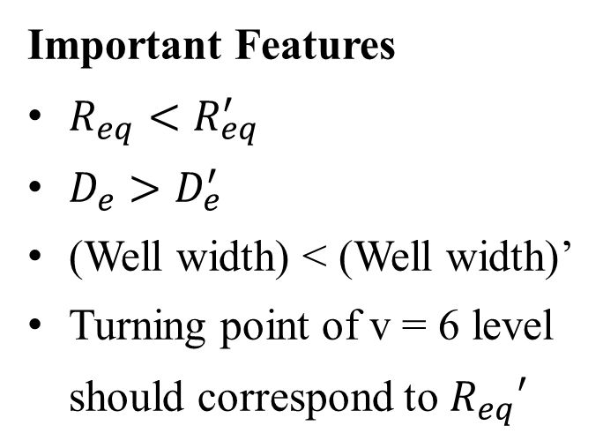
(D) Sketching molecular potential curves
v’=11
v’=12
First excited state curve
v’=10
v’=9
v’=8
5.3 eV
v’=7
v’=6
v’=5
$D_{e}$ (from part c)
Important Features
$R_{eq}<R_{eq}^{′}$
$D_{e}>D_{e}^{′}$
(Well width) < (Well width)’
Turning point of v = 6 level should correspond to $R_{eq}′$
“pressure in sample X is high”
v’=4
v’=3
v’=2
v’=1
v’=0
Ground state curve
v=10
v=9
v=8
7.8eV
v=7
v=6
$D_{e}$ (from part b)
v=5
v=4
Notice ground state curve is narrower than the excited state curve
v=3
v=2
v=1
v=0
Equilibrium radius shifts right for the excited state

Slide 12
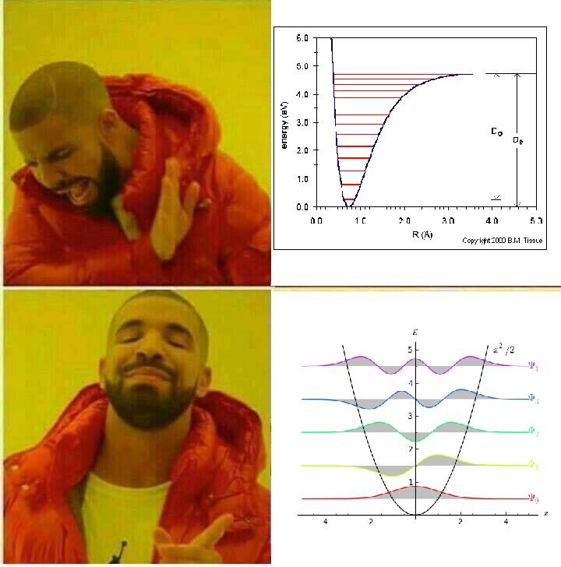

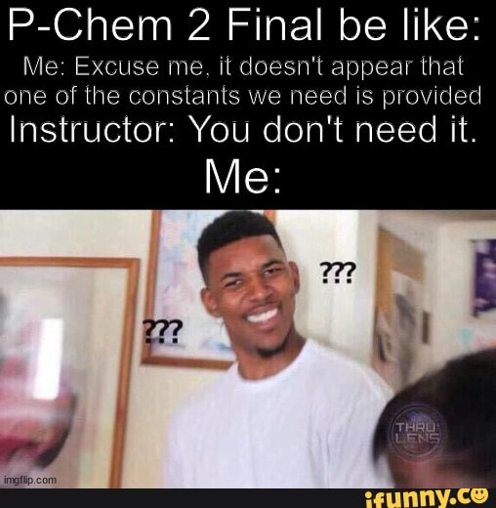
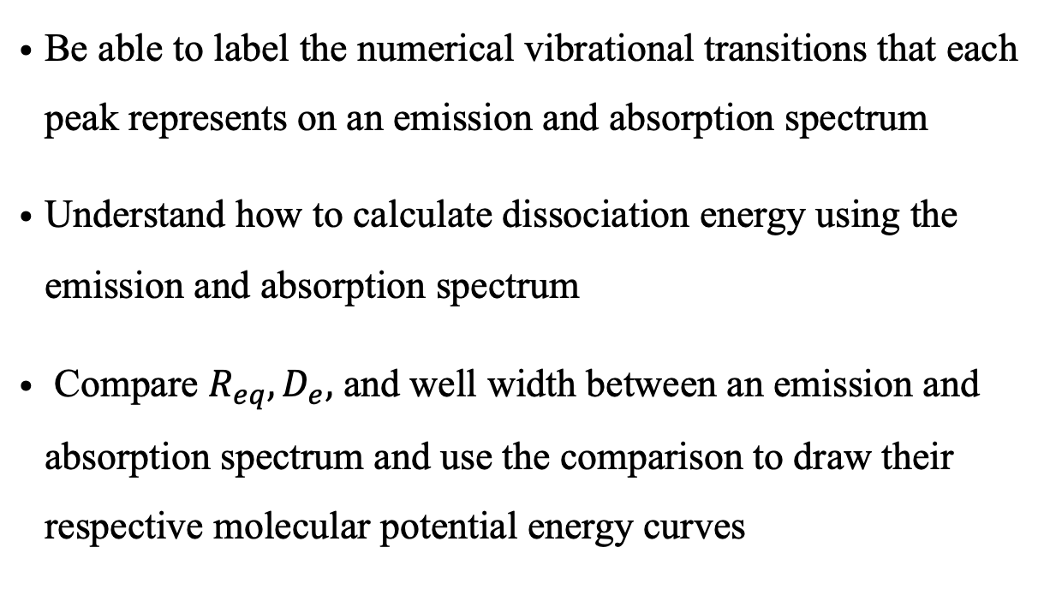
Key Takeaways
Be able to label the numerical vibrational transitions that each peak represents on an emission and absorption spectrum
Understand how to calculate dissociation energy using the emission and absorption spectrum
Compare $R_{eq}, D_{e},$ and well width between an emission and absorption spectrum and use the comparison to draw their respective molecular potential energy curves

