Slide 1
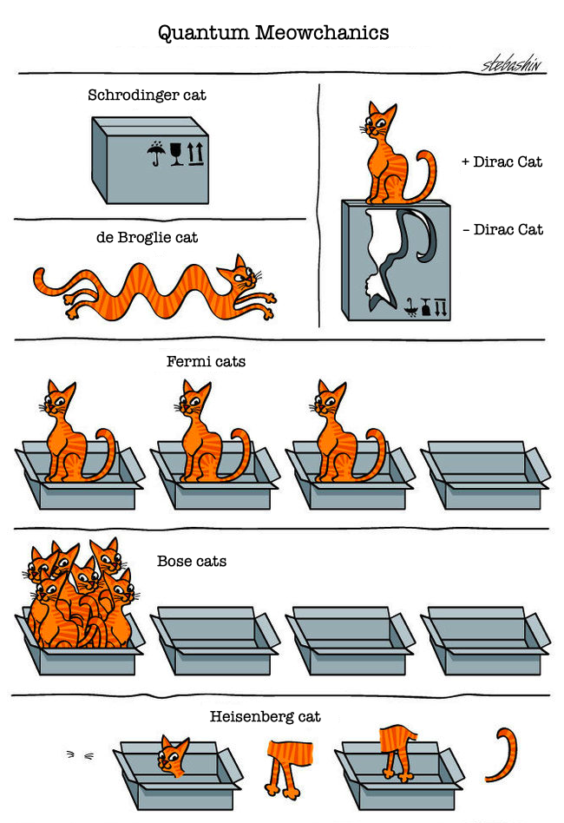
Calculation Session 4:
Exercise 1
Created by Jonathan Su (‘23)
Edited by Donovan Cho (‘25)
Edited by Vivian Liu (‘26)

Slide 2

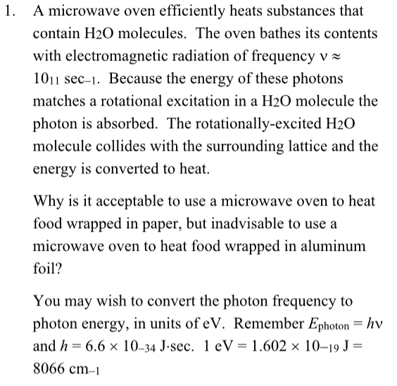


What do we know?
Electrons can absorb photons that are high enough in energy.

Slide 3
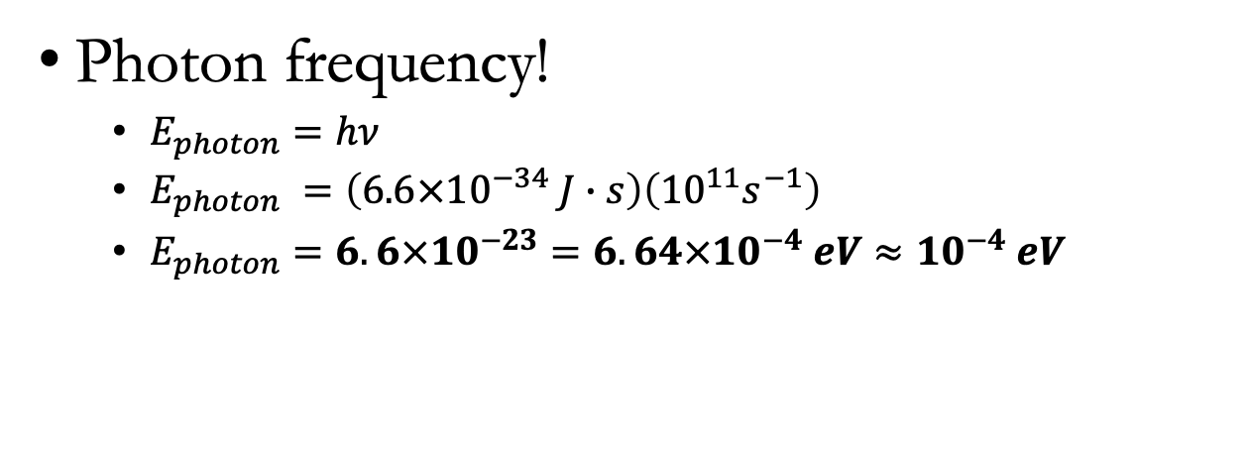
Given
Photon frequency!
  $E_{photon}=hν$
  $E_{photon} =\left(6.6×{10}^{−34} J∙s\right)\left({10}^{11}s^{−1}\right)$
  $E_{photon}=6.6×{10}^{−23}=6.64×{10}^{−4} eV≈{10}^{−4} eV$
Filled states for Al (metal)
Fermi Level

Slide 4
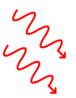
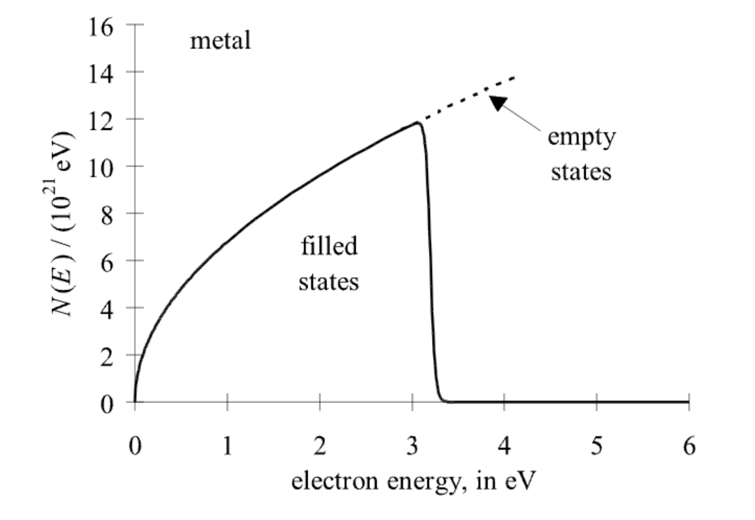

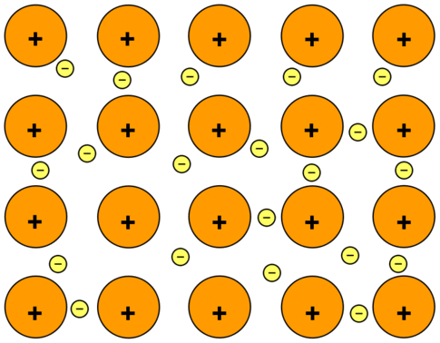
What does this mean?
E
KE transferred to atoms = heat
Metals can absorb electrons indefinitely

Slide 5

What does this mean?
I’m free!
Metals can absorb electrons indefinitely
→ Ionization
E
-

Slide 6

What about paper?
No heating
No fire
Energy gap > E_{photon}

Slide 7
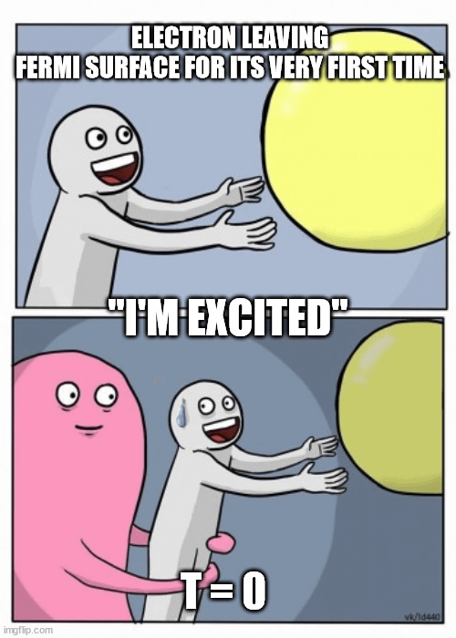
Key Takeaways
Please do not microwave metals.
Electrons can absorb photons that are high enough in energy → raise to next energy level.
Energy levels of metals are effectively continuous
  No band gap
Energy levels of molecular solids are much farther apart

