Slide 1


Calculation Session 4:
Exercise 5
Created by Brianna Morris (‘23)
Lauren de Silva (‘25)
Edited by: Kong Chen (‘26)
*Trying to overcome the band gap*

Slide 2
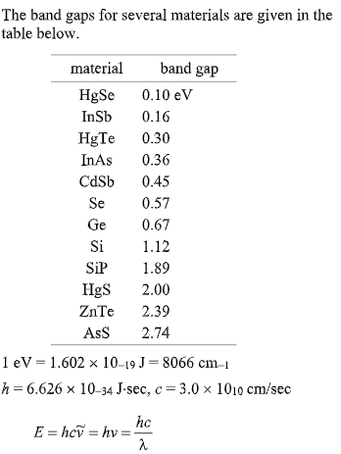

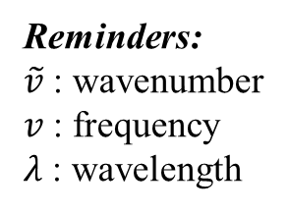
Select the material that would be most appropriate for detection…
Reminders:
$\tilde{v}$ : wavenumber
$v$ : frequency
$λ$ : wavelength

Slide 3


What does it mean for a material to detect a photon?
Photon $E=hc\tilde{v}$
-
detector
+
-
Valence band
Conduction
band

Slide 4
Which must be true about a material to detect a photon?
Option I: Band gap must be slightly smaller than the energy of the photon
Option II: Band gap must be slightly larger than the energy of the photon

Slide 5
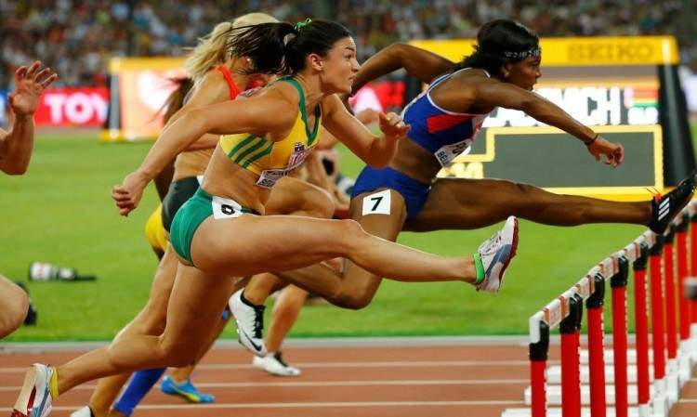


Don’t overjump the hurdle (band gap):
Waste energy
Slower to reach the ground
Band Gap

Slide 6
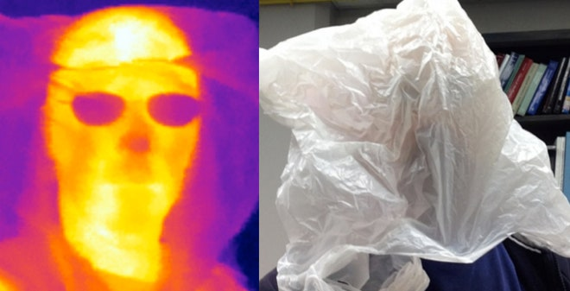

(A) Infrared radiation emitted by a human body
Given: $\tilde{v}$ = 1000 ${cm}^{−1}$ at 35 $℃$
Equation: $E=hc\tilde{v}$
Constants:
  $h=6.626x{10}^{−34} J∙s$
  $c=3.0x{10}^{10}\frac{cm}{s}$
  $1 eV=1.602x{10}^{−19} J$
Plug in: $E=hc\tilde{v}=\left(6.626x{10}^{−34}J∙s\right)\left(\frac{3.0x{10}^{10}cm}{s}\right)\left(1000 {cm}^{−1}\right)(\frac{1 eV}{1.602x{10}^{−19}J})$
$E=0.12 eV$

Slide 7
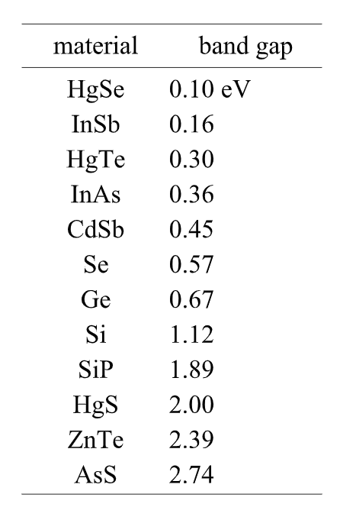



(A) Infrared radiation emitted by a human body
$E_{photon}=0.12 eV$
Between these two…
HgSe
InSb
0.1 eV
0.16 eV
3.1
3.12
3.16
HgSe has a band width $<$ 0.12 $eV$

Slide 8
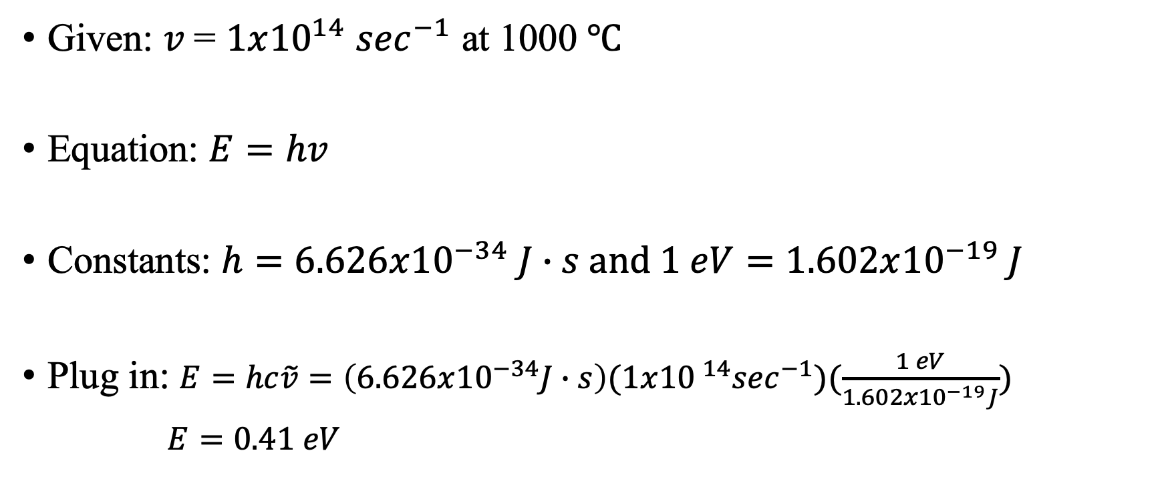
(B) Infrared radiation emitted by a jet engine
Given: $v$= $1x{10}^{14}$ $\sec^{−1}$ at 1000 $℃$
Equation: $E=hv$
Constants: $h=6.626x{10}^{−34} J∙s and 1 eV=1.602x{10}^{−19} J$
Plug in: $E=hc\tilde{v}=\left(6.626x{10}^{−34}J∙s\right)(1x{10 }^{14}\sec^{−1})(\frac{1 eV}{1.602x{10}^{−19}J})$
$E=0.41 eV$

Slide 9
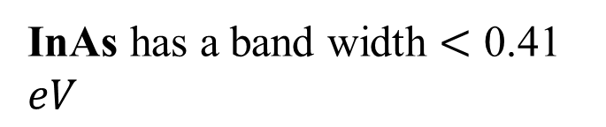

(B) Infrared radiation emitted by a jet engine
$E=0.41 eV$
Between these two…
InAs has a band width $<$ 0.41 $eV$

Slide 10

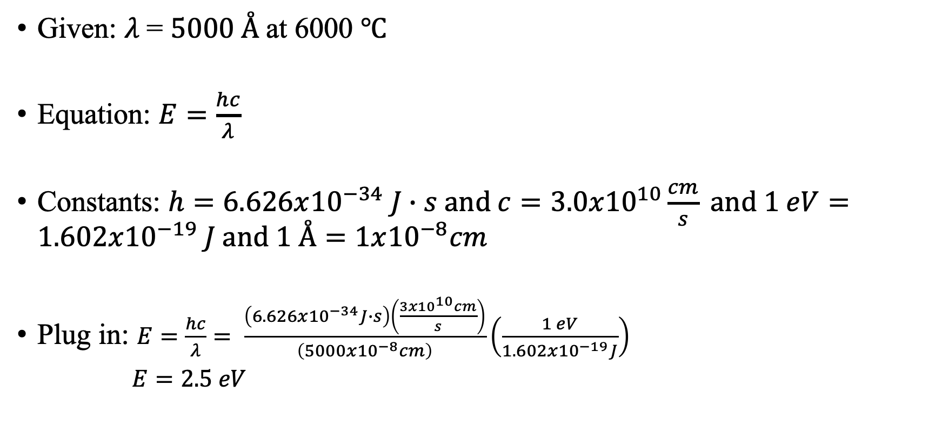
(C) Visible radiation emitted by the sun
Given: $λ$= $5000 Å$at 6000 $℃$
Equation: $E=\frac{hc}{λ}$
Constants: $h=6.626x{10}^{−34} J∙s and c=3.0x{10}^{10}\frac{cm}{s} and 1 eV=1.602x{10}^{−19} J and 1 Å=1x{10}^{−8}cm$
Plug in: $E=\frac{hc}{λ}= \frac{\left(6.626x{10}^{−34}J∙s\right)\left(\frac{3x{10}^{10}cm}{s}\right)}{\left(5000x{10}^{−8}cm\right)}\left(\frac{1 eV}{1.602x{10}^{−19}J}\right)$
$E=2.5 eV$

Slide 11
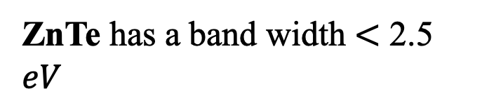

(C) Visible radiation emitted by the sun
$E=2.5 eV$
ZnTe has a band width $<$ 2.5 $eV$

Slide 12

Main Takeaways
A photon will be detected by a material if its energy is slightly greater than the characteristic band gap of the material
Know the different formulas for energy depending on whether you are given wavelength, frequency, or wavenumber

