Slide 1
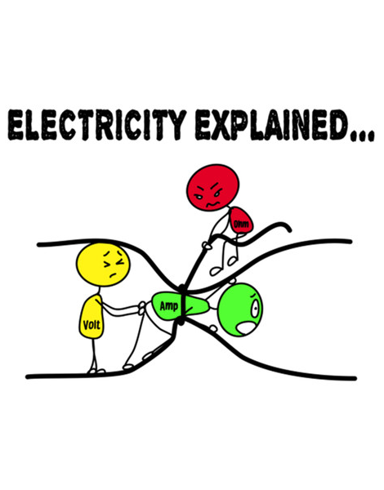
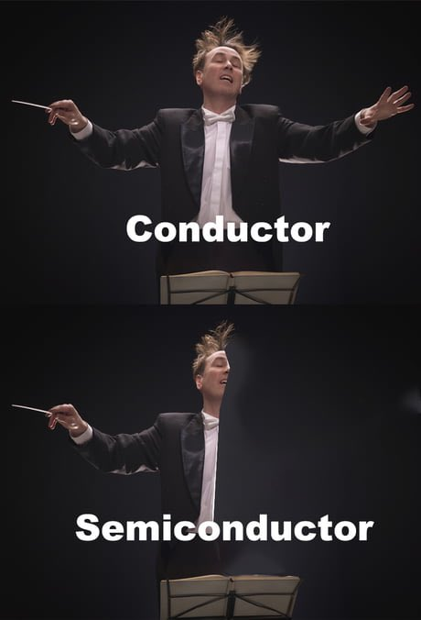

Calculation Session 4
Exercise 6
Created by Sanna Vedrine ('23)
Ashlyn Dumaw (‘25)
Edited by Amy Wu (‘26)

Slide 2
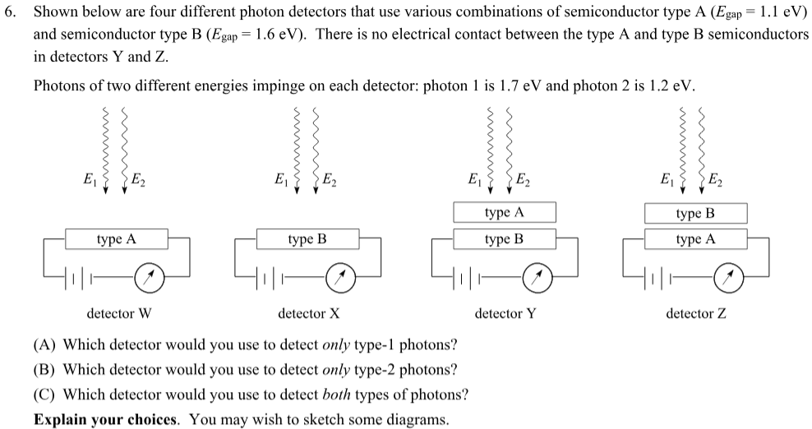


Slide 3
Interaction of Photons with Semiconductors
CASE I: E_{photon} ≥ E_{gap}
Photon’s energy is absorbed to excite electron across the semiconductor’s band gap
Once the electron is excited (conduction band) and given a potential difference in circuit (battery), current will flow
Ammeter will detect the current
photon
semiconductor
battery
ammeter
semiconductor energy levels
conduction band
band gap
-
valence band
Notes:
generic detector set up: semiconductor, potential difference, ammeter.
To review, we can zoom into the semiconductor energy levels. there is the valence and and conduction band. the difference between these bands is represented by the band gap (energy an electron needs to make the jump between levels).
when a photon interacts with a semiconductor, we can consider two main cases depending on the relative photon energy and band gap energy.
case 1 – photon has enough energy to excite electron across band gap. electron in conduction band (hence the name) will flow

Slide 4
Interaction of Photons with Semiconductors
CASE I: E_{photon} ≥ E_{gap}
Photon’s energy is absorbed to excite electron across the semiconductor’s band gap
Once the electron is excited (conduction band) and given a potential difference in circuit (battery), current will flow
Ammeter will detect the current
photon
semiconductor
battery
ammeter
CASE II: E_{photon} < E_{gap}
Photon doesn’t have enough energy to excite electron across the semiconductor’s band gap
No current will flow!
Photon passes through the semiconductor
semiconductor energy levels
conduction band
band gap
-
valence band
Notes:
in the second case, the photon doesn’t have enough energy to excite the electron and therefore no current will flow

Slide 5

Detector W
1.7 eV
1.2 eV
E1 > E_{gap, A}
1.7 > 1.1
E2 > E_{gap, A}
1.2 > 1.1
Both types of photons have enough energy to excite e- across band gap
Current flows and detector will detect both photon 1 and photon 2
TYPE A (E_{gap} = 1.1 eV)
-
Notes:
now that we have reviewed, lets take a look at the first given detector
like we just reviewed, first lets compare the energy of the photons to the energy gap of the semiconductor. ** photon1 more or less energy than gap of type A? and photon 2?

Slide 6
Detector X
1.7 eV
1.2 eV
E1 > E_{gap, B}
1.7 > 1.6
E2 < E_{gap, B}
1.2 < 1.6
Only photon 1 has enough energy to excite e- across band gap into conduction band
Current flows and detector will detect only photon 1
TYPE B (E_{gap} = 1.6 eV)
-
Notes:
now that we have reviewed, lets take a look at the first given detector
like we just reviewed, first lets compare the energy of the photons to the energy gap of the semiconductor. ** photon1 more or less energy than gap of type A? and photon 2?

Slide 7
Detector Y
1.7 eV
1.2 eV
E1 > E_{gap, A}
1.7 > 1.1
E2 > E_{gap, A}
1.2 > 1.1
No electrical contact
Both types of photons have enough energy to excite e- across band gap and will be absorbed by the cover
Neither photon will reach type B detector so there will be no current flow
TYPE A (E_{gap} = 1.1 eV)
TYPE B (E_{gap} = 1.6 eV)
Notes:
now that we have reviewed, lets take a look at the first given detector
like we just reviewed, first lets compare the energy of the photons to the energy gap of the semiconductor. ** photon1 more or less energy than gap of type A? and photon 2?

Slide 8
Detector Z
E1 > E_{gap, B}
1.7 > 1.6
E2 < E_{gap, B}
1.2 < 1.6
1.7 eV
1.2 eV
Photon 1 has enough energy to excite e- across band gap into type B and will be absorbed by the cover
Photon 2 will not be absorbed by the cover
Photon 2 has enough energy to excite e- across band gap of type A and is absorbed
Current flows and detector will detect only photon 2
E2 > E_{gap, A}
1.2 > 1.1
TYPE B (E_{gap} = 1.6 eV)
TYPE A (E_{gap} = 1.1 eV)
-

Slide 9

Summary of Photon Detectors
Detects both types of photons
(C)
Detects only type-1 photons
(A)
Detects no photons
Detects only type-2 photons
(B)

Slide 10
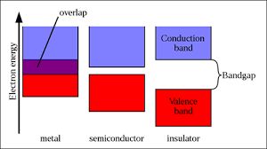
Key Takeaways
The semiconductor bandgap represents the minimum amount of energy to excite an electron from its bound state (valence band) to its free state (conduction band)
For the photon to be absorbed by the semiconductor, it must have enough energy to excite an electron across the band gap
For current to flow, there must be an electrical potential across the semiconductor (provided by the battery)

