Slide 1
Calculation Session 8:
Exercise 10
Created by Brianna Morris (‘23)
Edited by Dennis Wu (‘25), Lara Capellino (‘26)

Slide 2
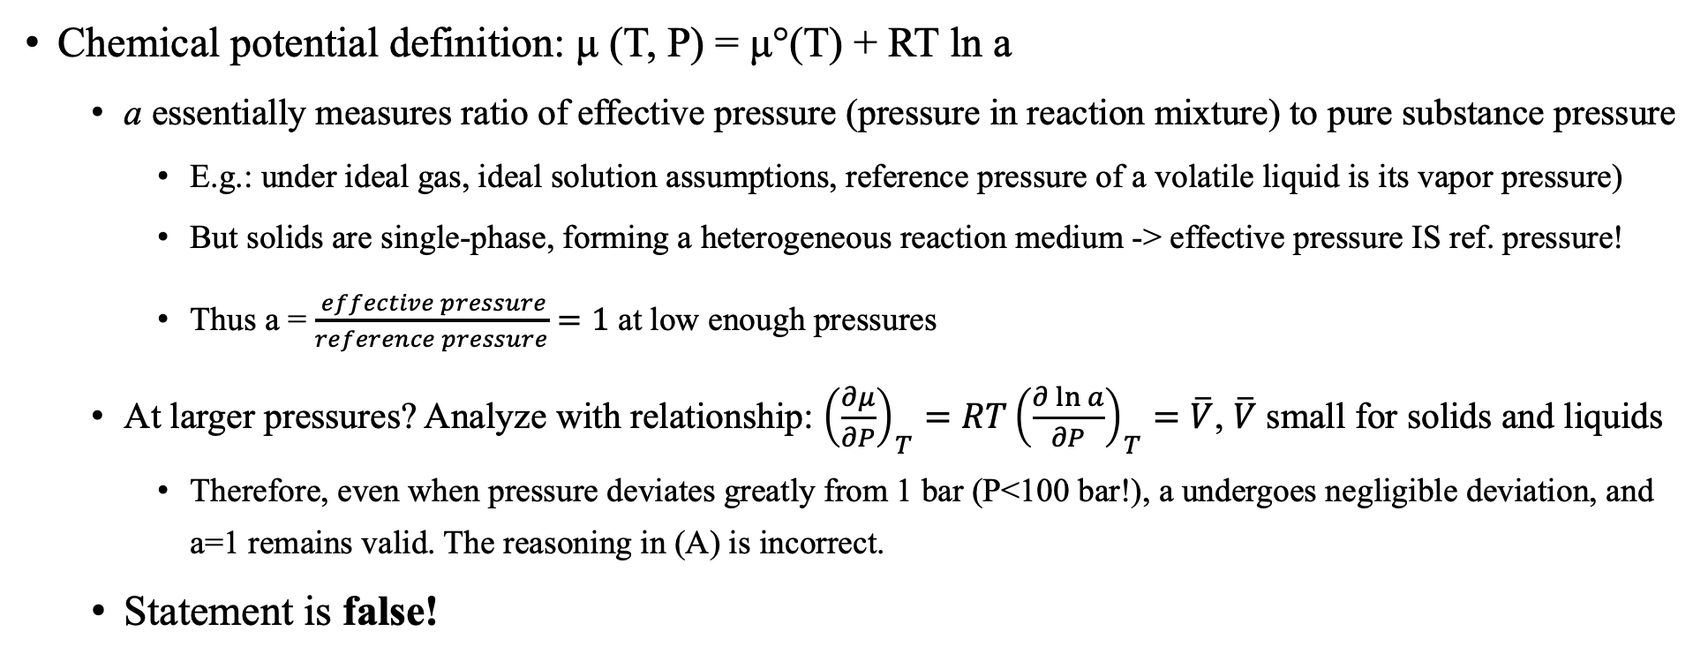
(A) The activity of a solid is set to 1 in an equilibrium constant because the pressure above the solid is approximately 1 bar
Chemical potential definition: μ (T, P) = μ°(T) + RT ln a
  a essentially measures ratio of effective pressure (pressure in reaction mixture) to pure substance pressure
    E.g.: under ideal gas, ideal solution assumptions, reference pressure of a volatile liquid is its vapor pressure)
    But solids are single-phase, forming a heterogeneous reaction medium -> effective pressure IS ref. pressure!
    Thus a = $\frac{ effective pressure}{reference pressure}=1$ at low enough pressures
  At larger pressures? Analyze with relationship: ${\left(\frac{∂μ}{∂P}\right)}_{T}={RT\left(\frac{∂\ln{a}}{∂P}\right)}_{T}=\overline{V}$, $\overline{V}$ small for solids and liquids
    Therefore, even when pressure deviates greatly from 1 bar (P<100 bar!), a undergoes negligible deviation, and a=1 remains valid. The reasoning in (A) is incorrect.
  Statement is false!

Slide 3
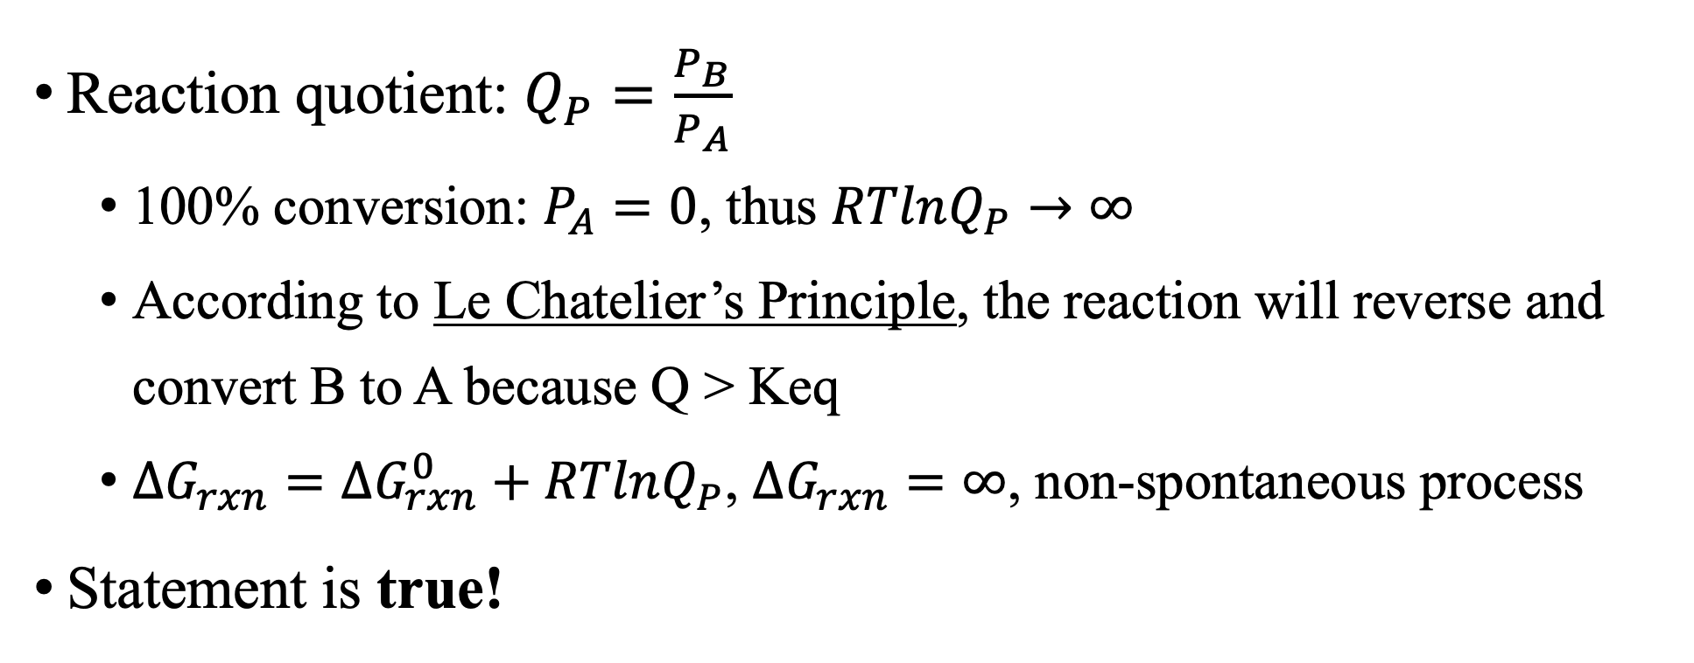
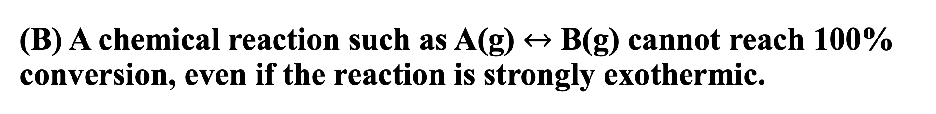
(B) A chemical reaction such as A(g) $↔$ B(g) cannot reach 100% conversion, even if the reaction is strongly exothermic.
Reaction quotient: $Q_{P}=\frac{P_{B}}{P_{A}}$
  100% conversion: $P_{A}=0$, thus $RTlnQ_{P}→∞$
  According to Le Chatelier’s Principle, the reaction will reverse and convert B to A because Q > Keq
  $∆G_{rxn}=∆G_{rxn}^{0}+RTlnQ_{P}$, $∆G_{rxn}=∞$, non-spontaneous process
Statement is true!

Slide 4
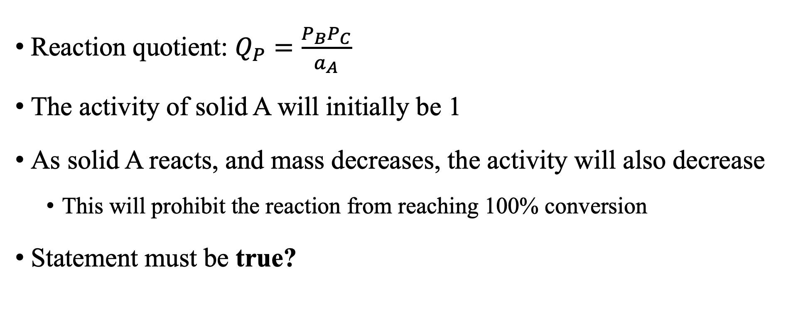
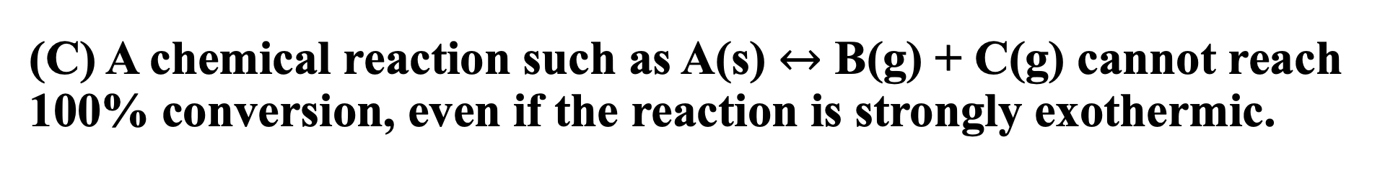
(C) A chemical reaction such as A(s) $↔$ B(g) + C(g) cannot reach 100% conversion, even if the reaction is strongly exothermic.
Reaction quotient: $Q_{P}=\frac{P_{B}P_{C}}{a_{A}}$
The activity of solid A will initially be 1
As solid A reacts, and mass decreases, the activity will also decrease
  This will prohibit the reaction from reaching 100% conversion
Statement must be true?

Slide 5
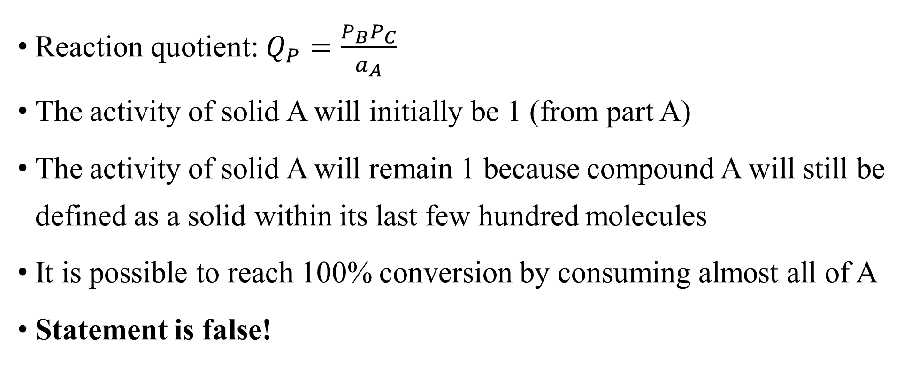
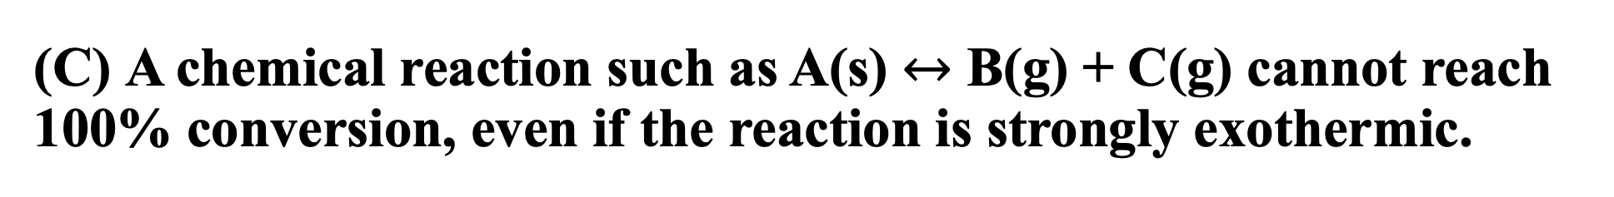
(C) A chemical reaction such as A(s) $↔$ B(g) + C(g) cannot reach 100% conversion, even if the reaction is strongly exothermic.
Reaction quotient: $Q_{P}=\frac{P_{B}P_{C}}{a_{A}}$
The activity of solid A will initially be 1 (from part A)
The activity of solid A will remain 1 because compound A will still be defined as a solid within its last few hundred molecules
It is possible to reach 100% conversion by consuming almost all of A
Statement is false!

Slide 6
(D) In lecture, it was shown that the extent of the reaction at equilibrium changes when the pressure changes (at constant temperature). Therefore, the equilibrium constant is a function of pressure.
Since the extent of the reaction changes when pressure changes, the partial pressures of each compound will also change
Thus, the equilibrium constant is a function of pressure
Statement must be true?

Slide 7
(D) In lecture, it was shown that the extent of the reaction at equilibrium changes when the pressure changes (at constant temperature). Therefore, the equilibrium constant is a function of pressure.
Although the partial pressures change, these change according to Keq
The equilibrium constant is a ratio of rate constants between the forward and reverse reactions
  Only variables that affect the rate constants can affect the equilibrium constant (Ex. Temperature)
  Therefore, the equilibrium constant is not a function of pressure
  Pressure can change position of equilibrium, but not the value of the constant itself
The statement is false!

Slide 8
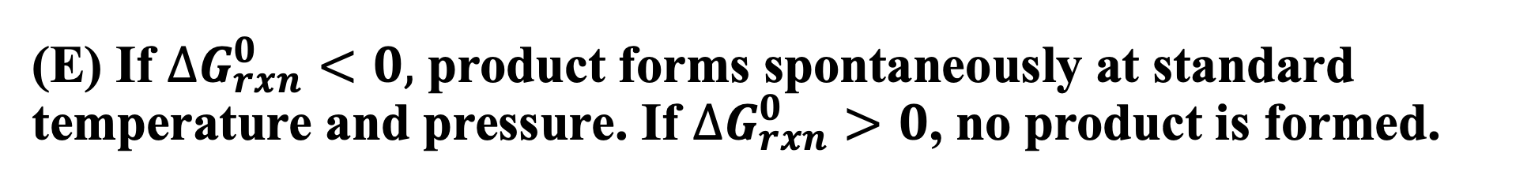
(E) If $∆G_{rxn}^{0}<0,$ product forms spontaneously at standard temperature and pressure. If $∆G_{rxn}^{0}>0$, no product is formed.
The key indicator for spontaneity is Gibbs free energy
  If Gibbs free energy is negative, then the process is spontaneous
  If Gibbs free energy is positive, then the process is not spontaneous and no product will form
Both statements must be true?

Slide 9
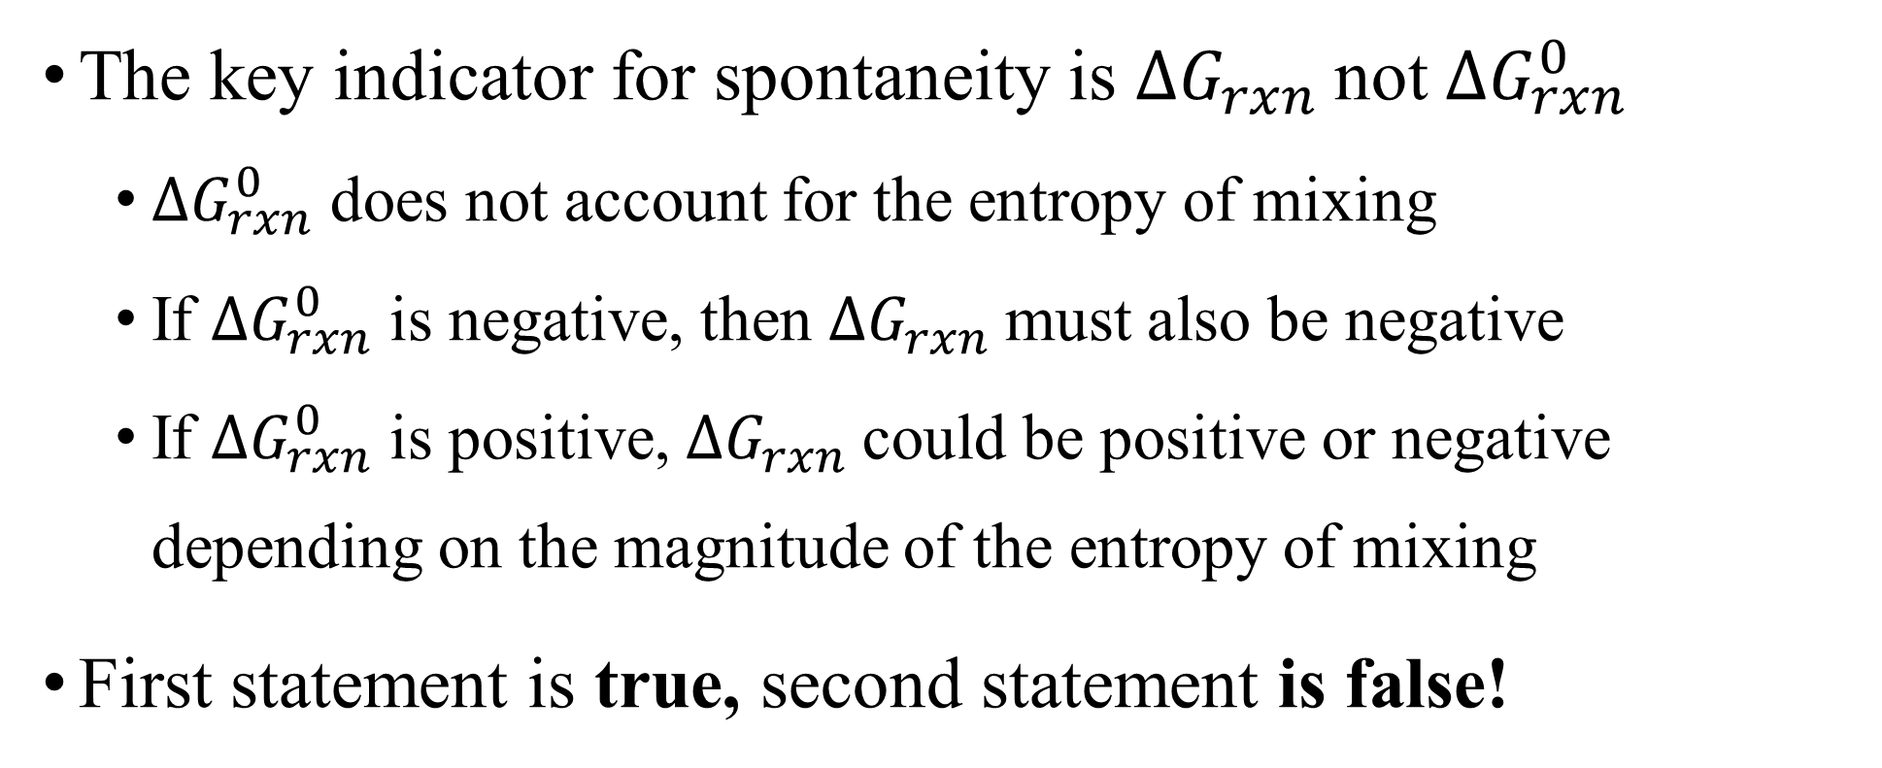
(E) If $∆G_{rxn}^{0}<0,$ product forms spontaneously at standard temperature and pressure. If $∆G_{rxn}^{0}>0$, no product is formed.
The key indicator for spontaneity is $∆G_{rxn}$not $∆G_{rxn}^{0}$
  $∆G_{rxn}^{0}$ does not account for the entropy of mixing
  If $∆G_{rxn}^{0}$ is negative, then $∆G_{rxn}$must also be negative
  If $∆G_{rxn}^{0}$ is positive, $∆G_{rxn}$could be positive or negative depending on the magnitude of the entropy of mixing
First statement is true, second statement is false!

Slide 10
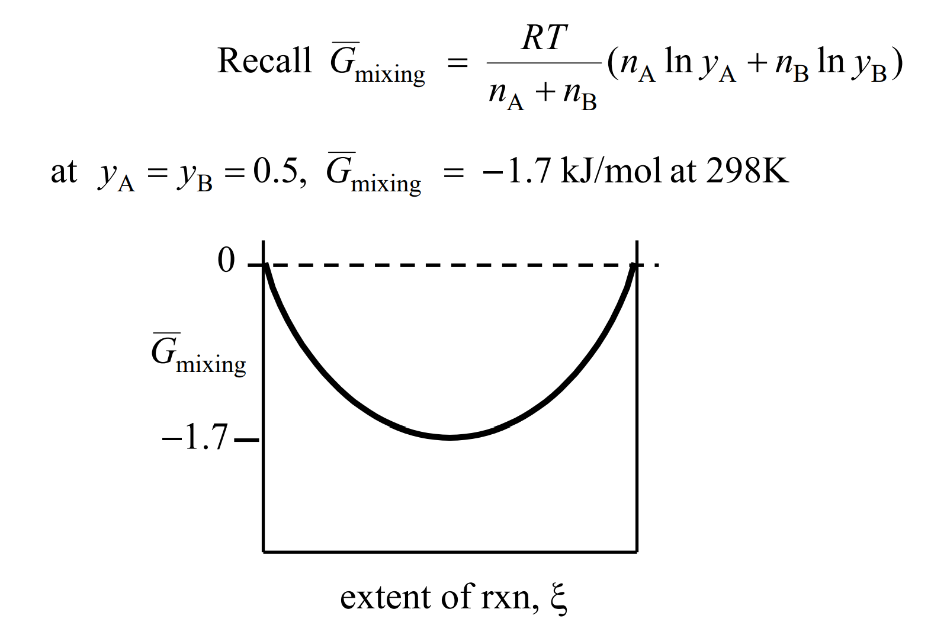
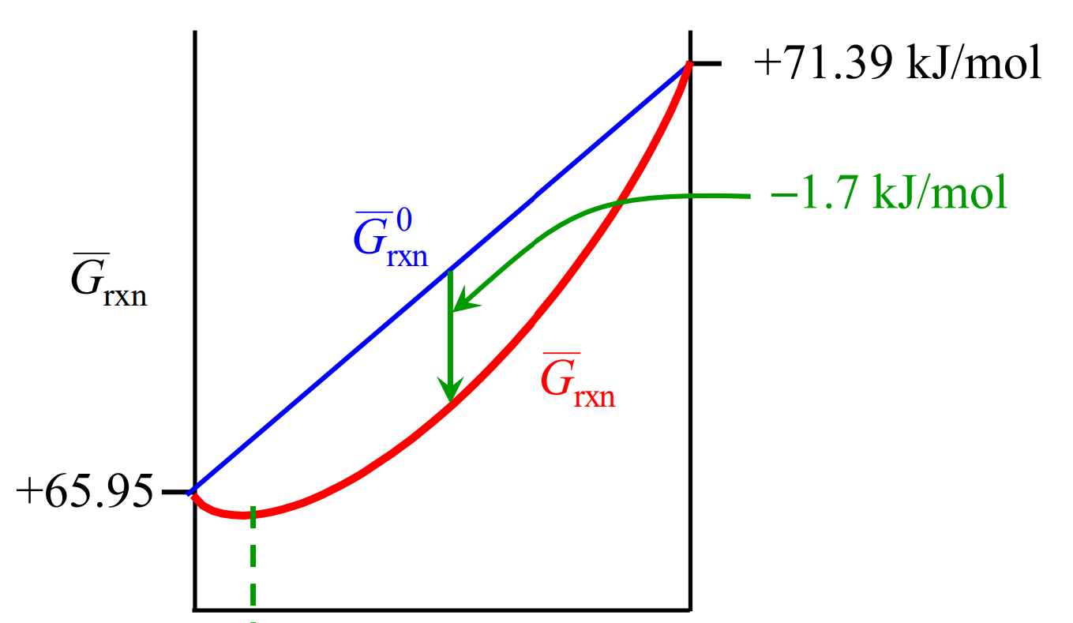
(E) If $∆G_{rxn}^{0}<0,$ product forms spontaneously at standard temperature and pressure. If $∆G_{rxn}^{0}>0$, no product is formed.

Slide 11
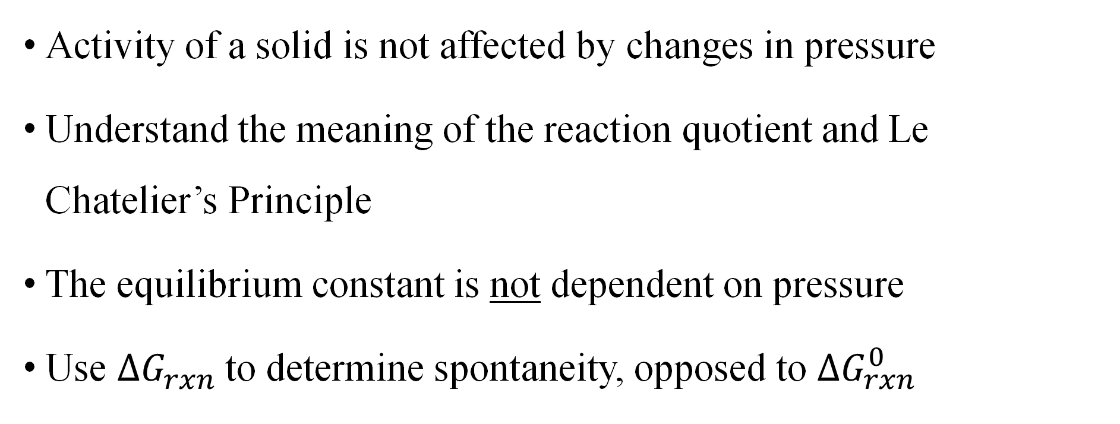
Main Takeaways
Activity of a solid is not affected by changes in pressure
Understand the meaning of the reaction quotient and Le Chatelier’s Principle
The equilibrium constant is not dependent on pressure
Use $∆G_{rxn}$to determine spontaneity, opposed to $∆G_{rxn}^{0}$

