Slide 1


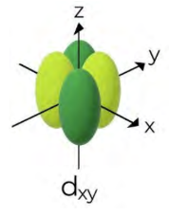
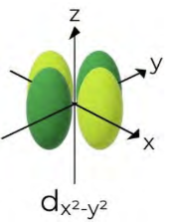
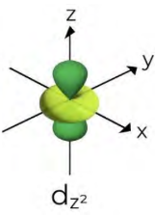
Calculation Session 8
Exercise 11
Created by Kaleigh Soucy (‘23)
Edited by Ashlyn Dumaw (‘25)
Kong Chen (‘26)

Slide 2
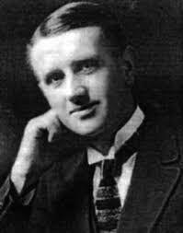
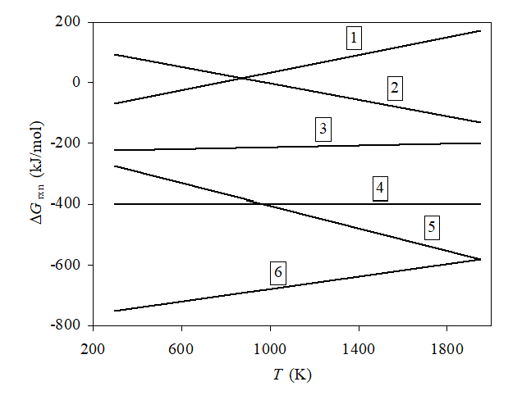
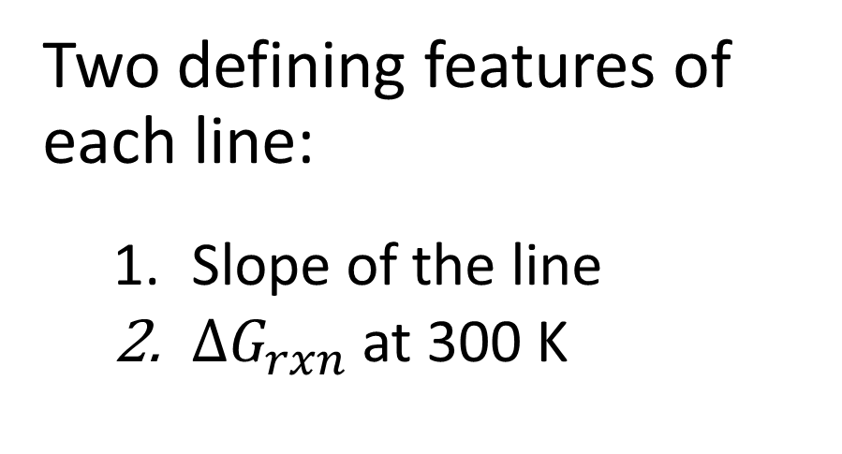
Inspecting the Ellingham diagram
Two defining features of each line:
  Slope of the line
  $∆G_{rxn}$ at 300 K

Slide 3
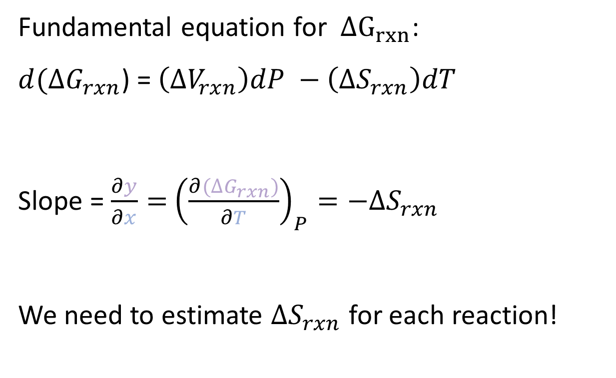

Slope of the line
Fundamental equation for $∆G_{rxn}$:
$d(∆G_{rxn}$) = $\left(∆V_{rxn}\right)dP −\left(∆S_{rxn}\right)dT$
Slope = $\frac{∂y}{∂x}=$ ${\left(\frac{∂(∆G_{rxn})}{∂T}\right)}_{P}=−∆S_{rxn}$
We need to estimate $∆S_{rxn}$ for each reaction!
$$∆S_{rxn}∝∆n_{gas}$$

Slide 4
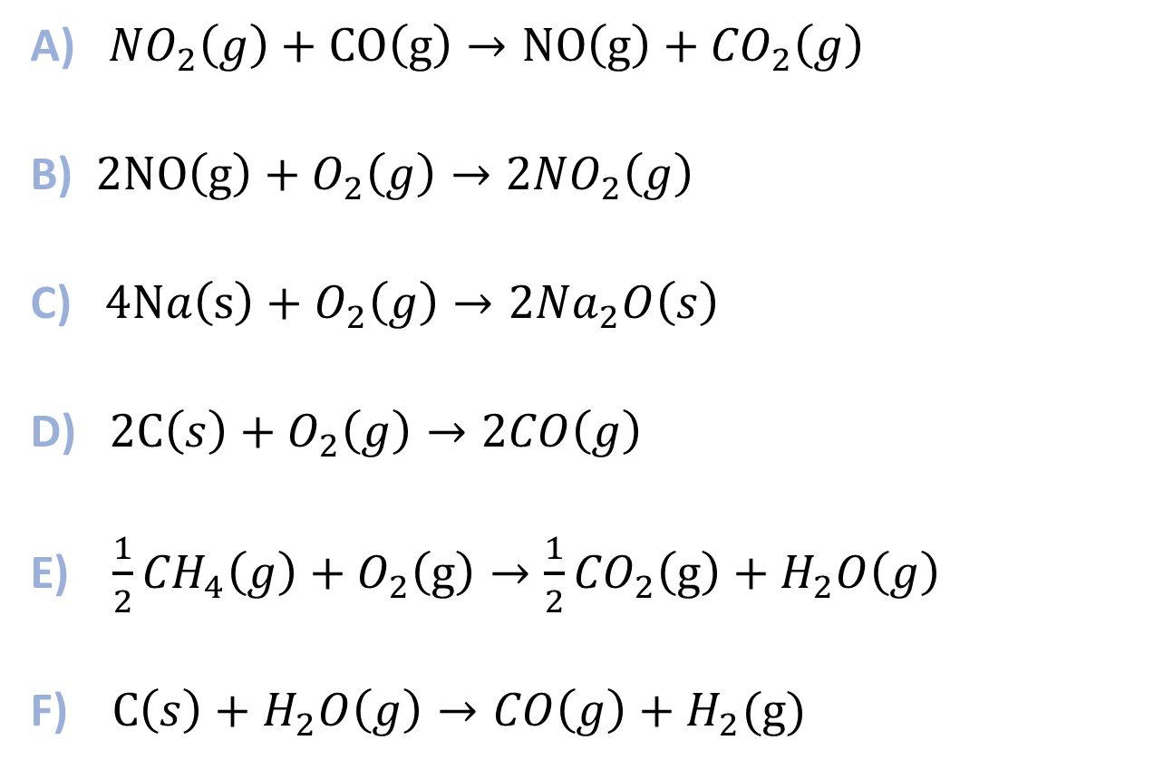

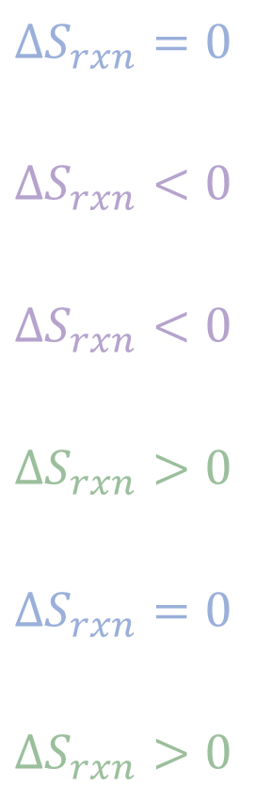

Looking at $∆S_{rxn}$
A) ${ NO}_{2}\left(g\right)+CO\left(g\right)→NO\left(g\right)+{CO}_{2}\left(g\right)$
B) ${2NO\left(g\right)+O}_{2}\left(g\right)→{2NO}_{2}\left(g\right)$
C) ${ 4Na\left(s\right)+O}_{2}\left(g\right)→{2Na}_{2}O\left(s\right)$
D) ${ 2C\left(s\right)+O}_{2}\left(g\right)→2CO\left(g\right)$
E) ${\frac{1}{2}CH}_{4}\left(g\right)+O_{2}\left(g\right)→\frac{1}{2}{CO}_{2}\left(g\right)+H_{2}O\left(g\right)$
F) ${ C\left(s\right)+H}_{2}O\left(g\right)→CO\left(g\right)+H_{2}(g)$
$$∆n_{A,gas}=2−2=0$$
$$∆n_{B,gas}=2−3=−1$$
$$∆n_{C,gas}=0−1=−1$$
$$∆n_{D,gas}=2−1=+1$$
$$∆n_{E,gas}=1.5−1.5=0$$
$$∆n_{F,gas}=2−1=+1$$
$$∆S_{rxn}=0$$
$$∆S_{rxn}<0$$
$$∆S_{rxn}<0$$
$$∆S_{rxn}>0$$
$$∆S_{rxn}=0$$
$$∆S_{rxn}>0$$

Slide 5
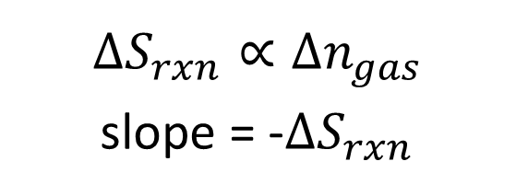

Looking at $∆S_{rxn}$
$$∆S_{rxn}∝∆n_{gas}$$
slope = -$∆S_{rxn}$
A) ${ NO}_{2}\left(g\right)+CO\left(g\right)→NO\left(g\right)+{CO}_{2}\left(g\right)$
B) ${2NO\left(g\right)+O}_{2}\left(g\right)→{2NO}_{2}\left(g\right)$
C) ${ 4Na\left(s\right)+O}_{2}\left(g\right)→{2Na}_{2}O\left(s\right)$
D) ${ 2C\left(s\right)+O}_{2}\left(g\right)→2CO\left(g\right)$
E) ${\frac{1}{2}CH}_{4}\left(g\right)+O_{2}\left(g\right)→\frac{1}{2}{CO}_{2}\left(g\right)+H_{2}O\left(g\right)$
F) ${ C\left(s\right)+H}_{2}O\left(g\right)→CO\left(g\right)+H_{2}(g)$
$$∆S_{rxn}=0$$
$$∆S_{rxn}<0$$
$$∆S_{rxn}<0$$
$$∆S_{rxn}>0$$
$$∆S_{rxn}=0$$
$$∆S_{rxn}>0$$
Positive slopes: B, C
Flat lines:
A, E
Negative slopes: D, F

Slide 6
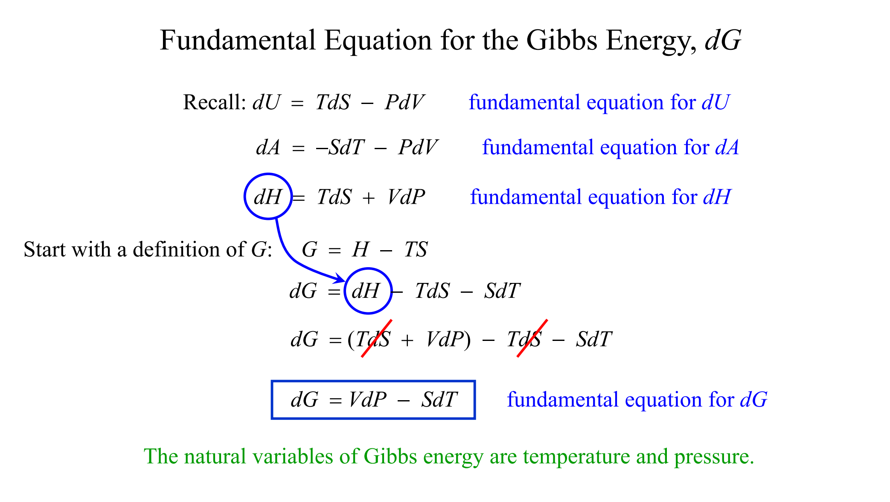
Thermo Lecture 9

Slide 7
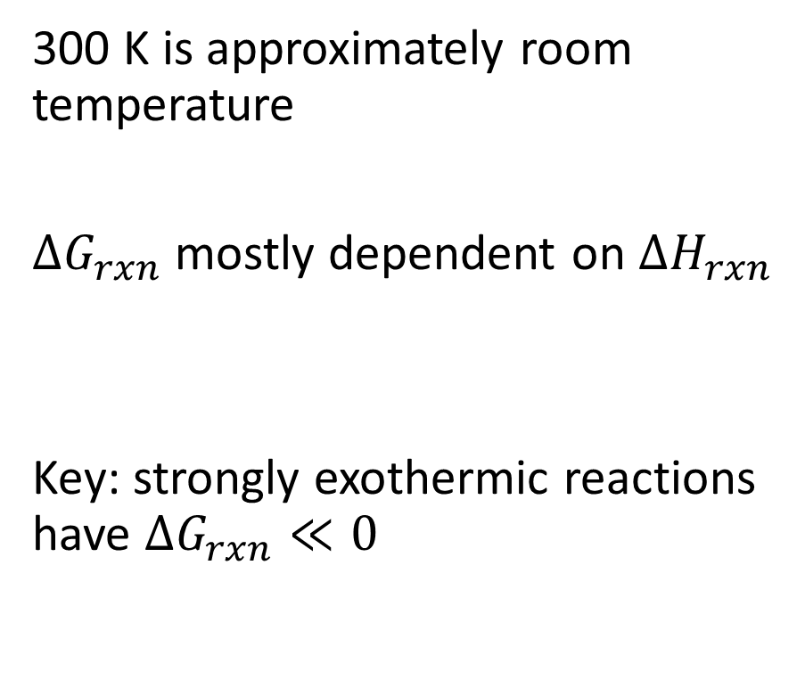
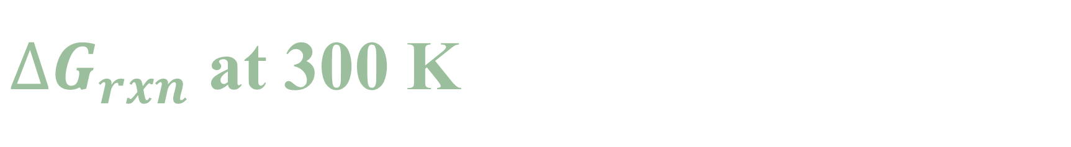
$∆G_{rxn}$ at 300 K
300 K is approximately room temperature
$∆G_{rxn}$ mostly dependent on $∆H_{rxn}$
Key: strongly exothermic reactions have $∆G_{rxn}≪0$

Slide 8

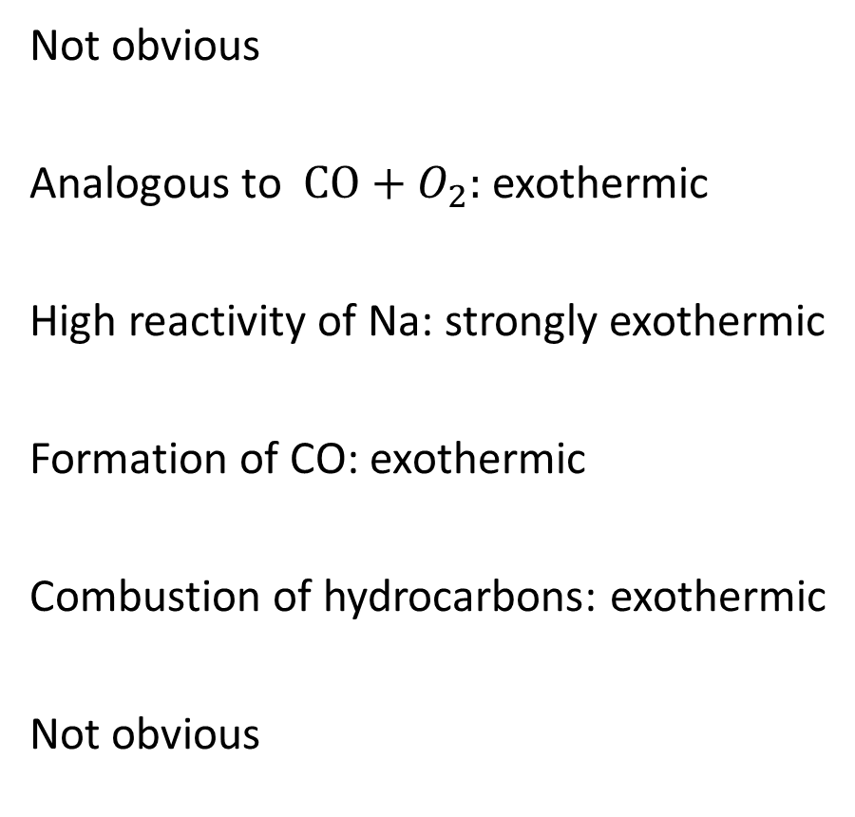
Looking at $∆G_{rxn}$
A) ${ NO}_{2}\left(g\right)+CO\left(g\right)→NO\left(g\right)+{CO}_{2}\left(g\right)$
B) ${2NO\left(g\right)+O}_{2}\left(g\right)→{2NO}_{2}\left(g\right)$
C) ${ 4Na\left(s\right)+O}_{2}\left(g\right)→{2Na}_{2}O\left(s\right)$
D) ${ 2C\left(s\right)+O}_{2}\left(g\right)→2CO\left(g\right)$
E) ${\frac{1}{2}CH}_{4}\left(g\right)+O_{2}\left(g\right)→\frac{1}{2}{CO}_{2}\left(g\right)+H_{2}O\left(g\right)$
F) ${ C\left(s\right)+H}_{2}O\left(g\right)→CO\left(g\right)+H_{2}(g)$
Not obvious
Analogous to ${ CO+O}_{2}:$ exothermic
High reactivity of Na: strongly exothermic
Formation of CO: exothermic
Combustion of hydrocarbons: exothermic
Not obvious

Slide 9
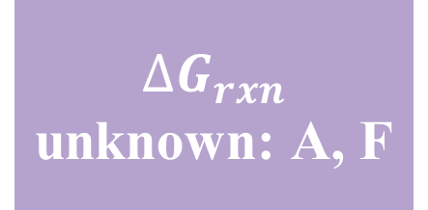
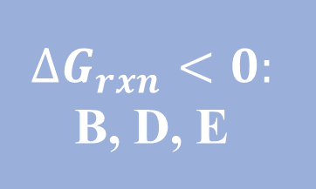
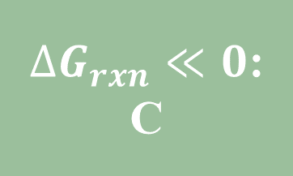
Looking at $∆G_{rxn}$
A) ${ NO}_{2}\left(g\right)+CO\left(g\right)→NO\left(g\right)+{CO}_{2}\left(g\right)$
B) ${2NO\left(g\right)+O}_{2}\left(g\right)→{2NO}_{2}\left(g\right)$
C) ${ 4Na\left(s\right)+O}_{2}\left(g\right)→{2Na}_{2}O\left(s\right)$
D) ${ 2C\left(s\right)+O}_{2}\left(g\right)→2CO\left(g\right)$
E) ${\frac{1}{2}CH}_{4}\left(g\right)+O_{2}\left(g\right)→\frac{1}{2}{CO}_{2}\left(g\right)+H_{2}O\left(g\right)$
F) ${ C\left(s\right)+H}_{2}O\left(g\right)→CO\left(g\right)+H_{2}(g)$
Not obvious
Exothermic
Strongly exothermic
Exothermic
Exothermic
Not obvious
$∆G_{rxn}≪0$:
C
$$∆G_{rxn}<0:$$
B, D, E
$∆G_{rxn}$ unknown: A, F

Slide 10
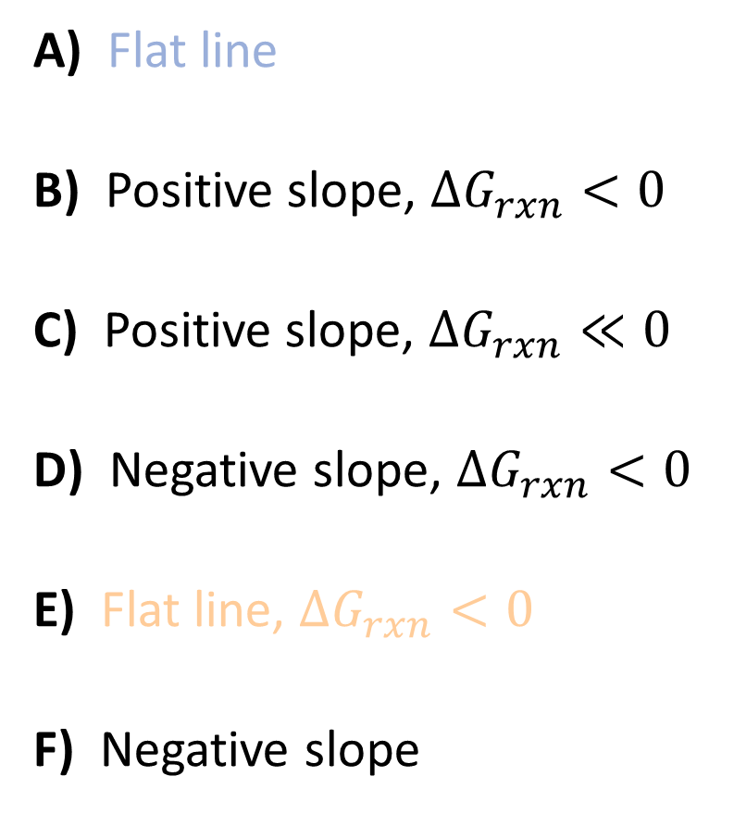
Looking at the reactions
A) Flat line
B) Positive slope, $∆G_{rxn}<0$
C) Positive slope, $∆G_{rxn}≪0$
D) Negative slope, $∆G_{rxn}<0$
E) Flat line, $∆G_{rxn}<0$
F) Negative slope

Slide 11
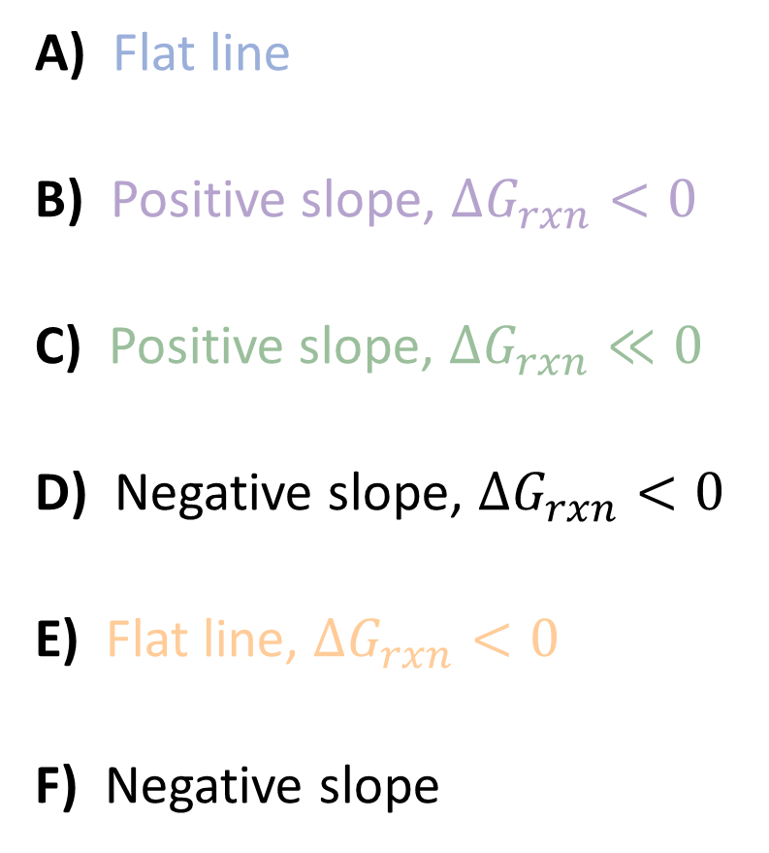
Looking at the reactions
A) Flat line
B) Positive slope, $∆G_{rxn}<0$
C) Positive slope, $∆G_{rxn}≪0$
D) Negative slope, $∆G_{rxn}<0$
E) Flat line, $∆G_{rxn}<0$
F) Negative slope

Slide 12
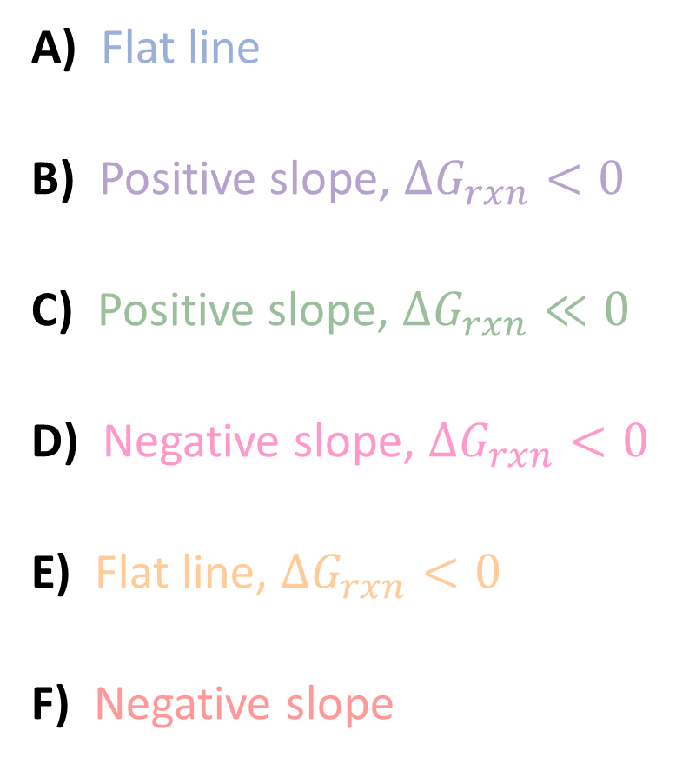
Looking at the reactions
A) Flat line
B) Positive slope, $∆G_{rxn}<0$
C) Positive slope, $∆G_{rxn}≪0$
D) Negative slope, $∆G_{rxn}<0$
E) Flat line, $∆G_{rxn}<0$
F) Negative slope

Slide 13
Looking at the reactions
A) Line 3
B) Line 1
C) Line 6
D) Line 5
E) Line 4
F) Line 2

Slide 14
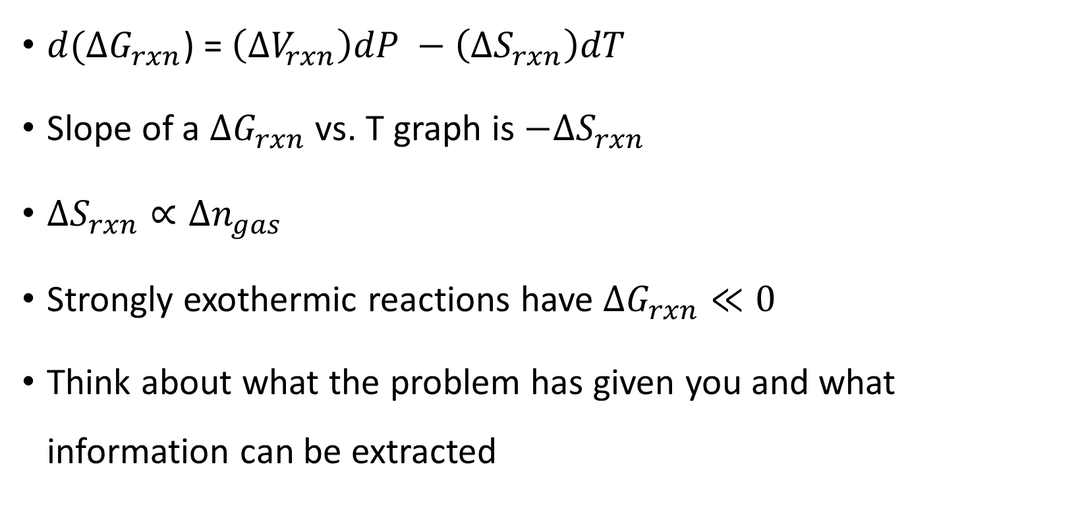
Key Takeaways
A) Line 3
B) Line 1
C) Line 6
D) Line 5
E) Line 4
F) Line 2
$d(∆G_{rxn}$) = $\left(∆V_{rxn}\right)dP −\left(∆S_{rxn}\right)dT$
Slope of a $∆G_{rxn}$ vs. T graph is $−∆S_{rxn}$
$∆S_{rxn}∝∆n_{gas}$
Strongly exothermic reactions have $∆G_{rxn}≪0$
Think about what the problem has given you and what information can be extracted

