Slide 1
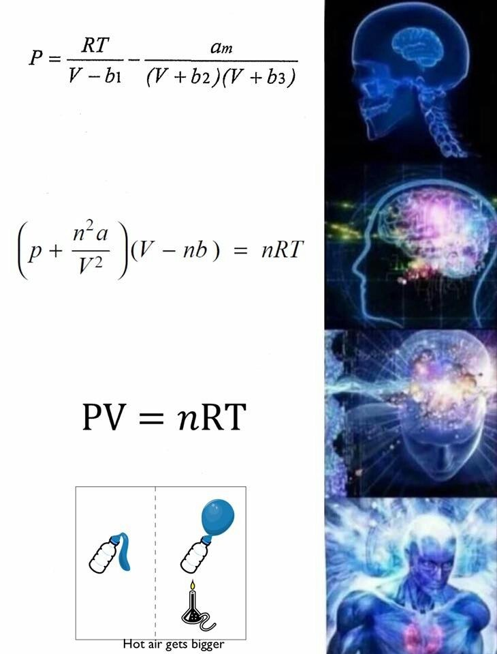

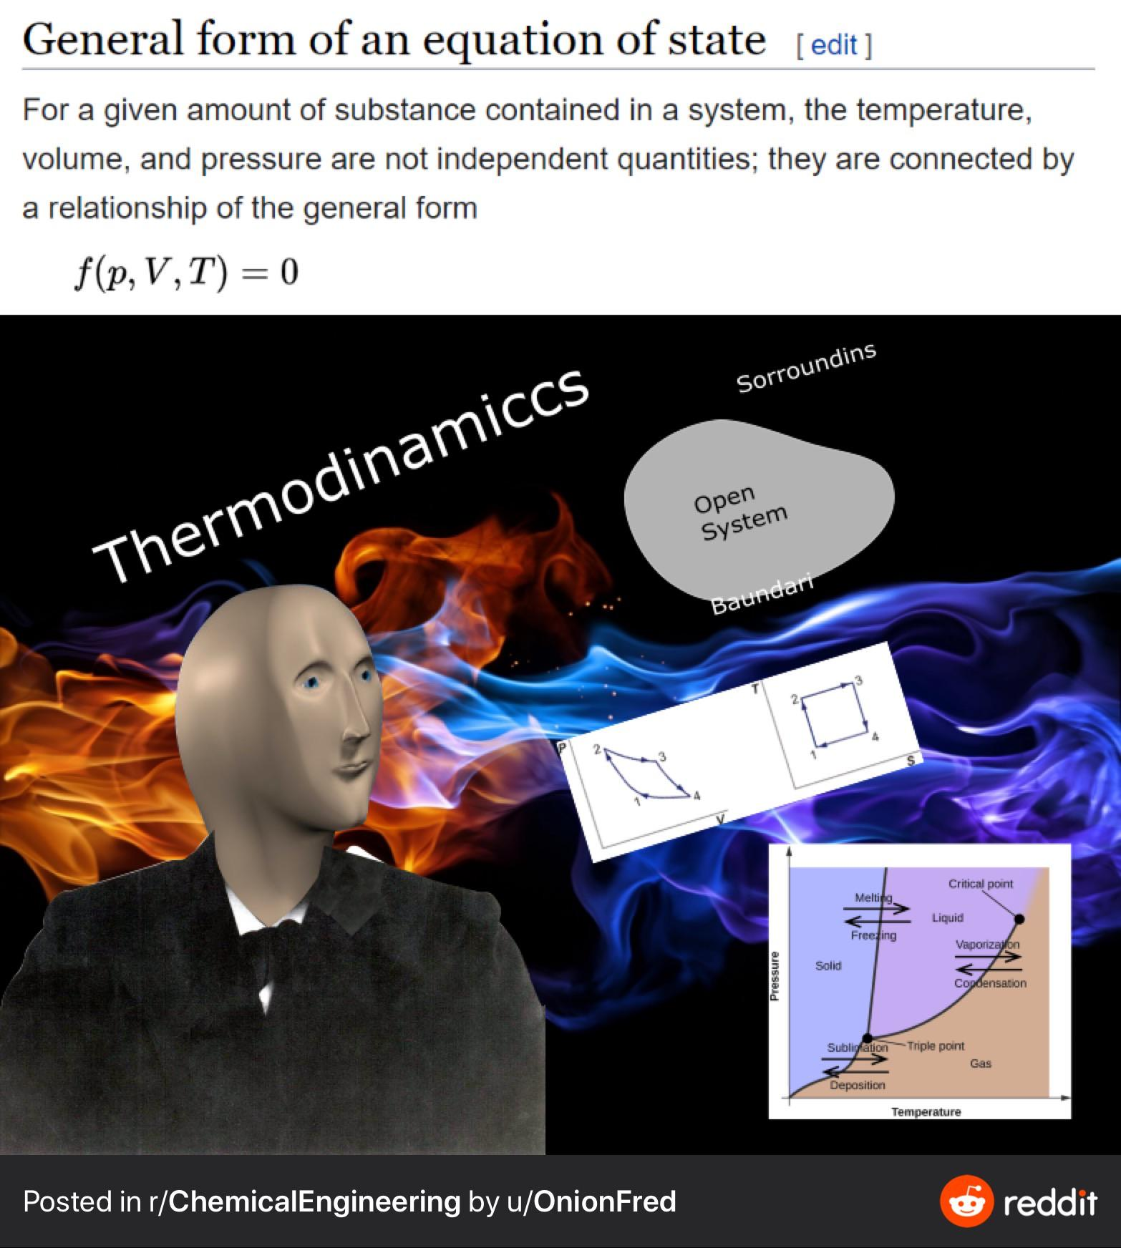
Calculation Session 8
Exercise 2
Leon Lee (‘23)
Donovan Cho (‘25)
Vivian Liu (‘26)

Slide 2
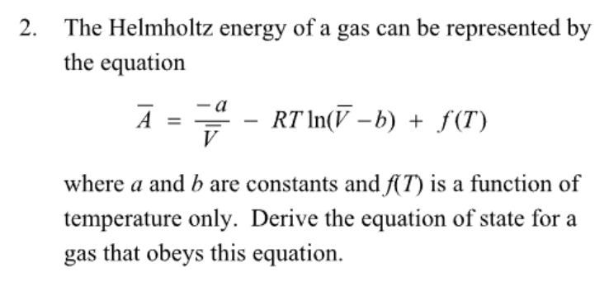

Givens

Slide 3

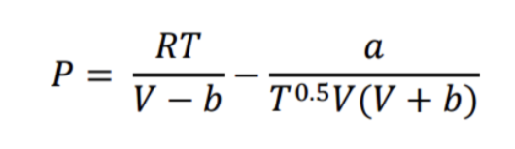

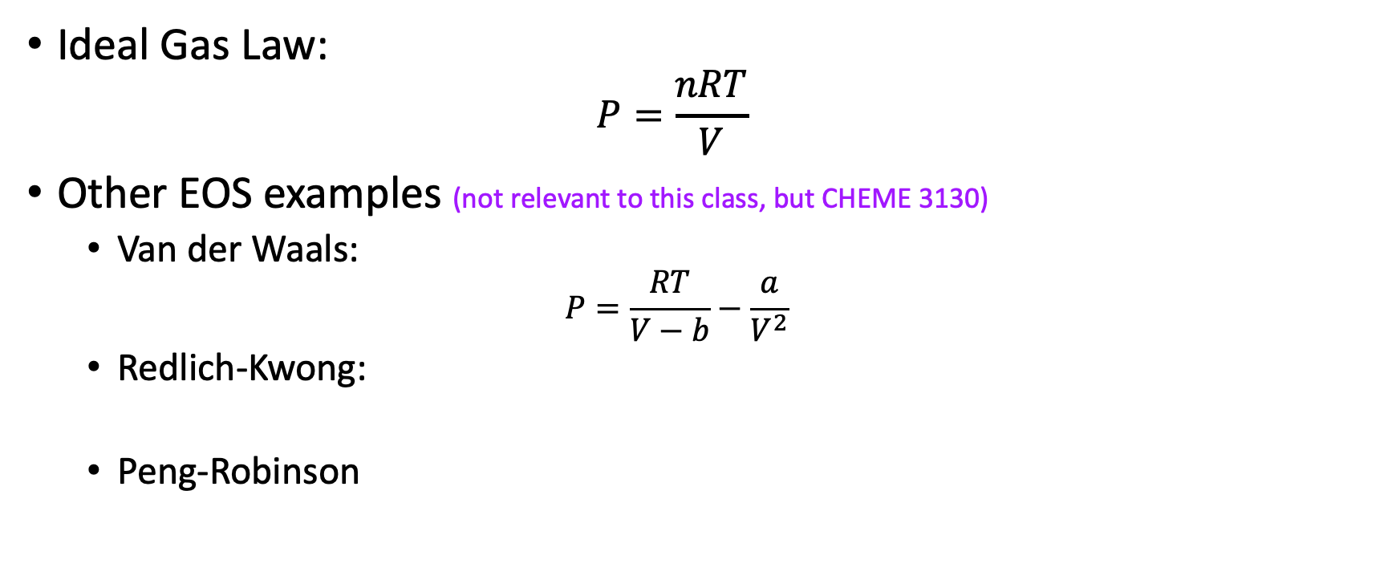
What is an equation of state (EOS)?
Ideal Gas Law:
  $$P=\frac{nRT}{V}$$
Other EOS examples (not relevant to this class, but CHEME 3130)
  Van der Waals:
  $$P=\frac{RT}{V−b}−\frac{a}{V^{2}}$$
  Redlich-Kwong:
  Peng-Robinson

Slide 4
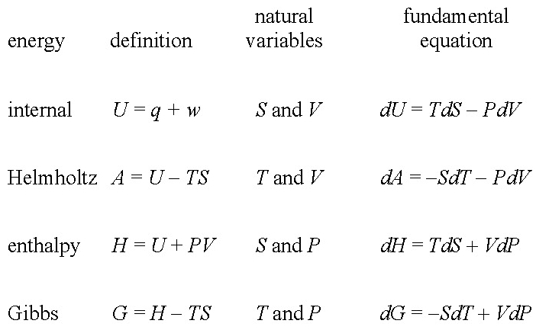
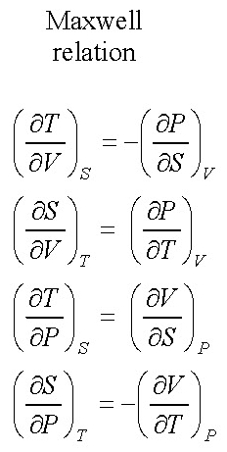
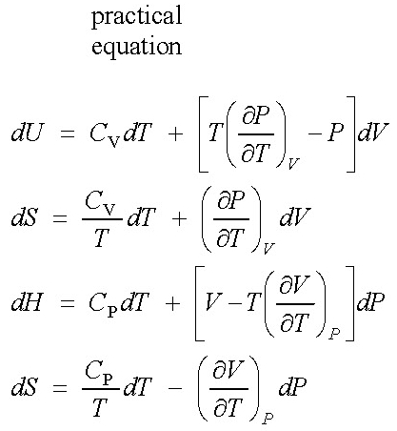
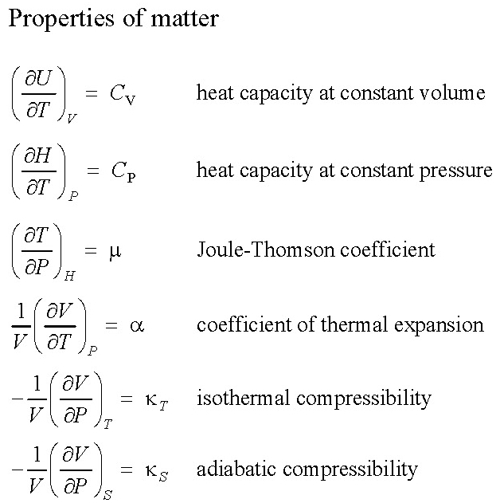
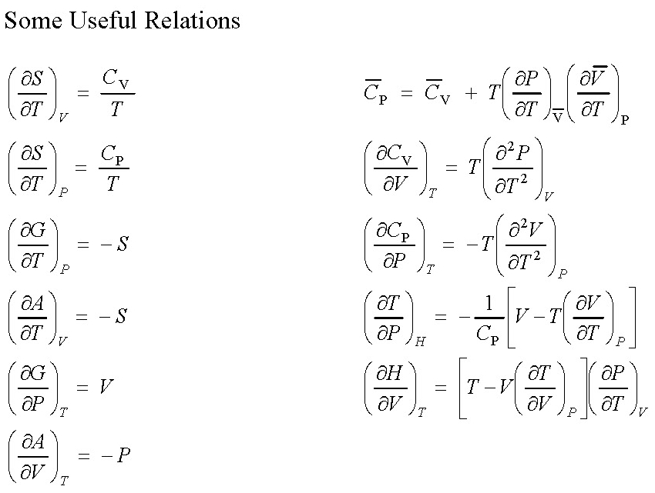
Recap: The Equations of Thermodynamics
need C_{P}
or C_{V}
and an
equation
of state.
Lecture T10, slide 5

Slide 5

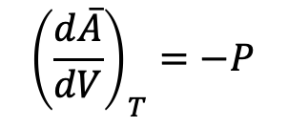
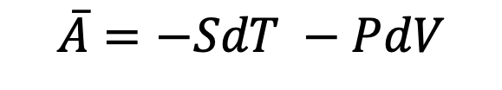


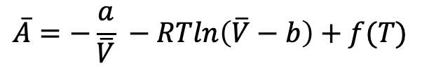
Determining EOS
0
$$\overline{A}=−SdT −PdV$$
$${\left(\frac{d\overline{A}}{dV}\right)}_{T}=−P$$
$$\overline{A}=−\frac{a}{\overline{V}} −RTln\left(\overline{V}−b\right)+f(T)$$
$${\left(\frac{d\overline{A}}{dV}\right)}_{T} = \frac{a}{{\overline{V}}^{2}} −\frac{RT}{\overline{V}−b} =−P$$
$$P=−\frac{a}{{\overline{V}}^{2}}+\frac{RT}{\overline{V}−b}$$

Slide 6

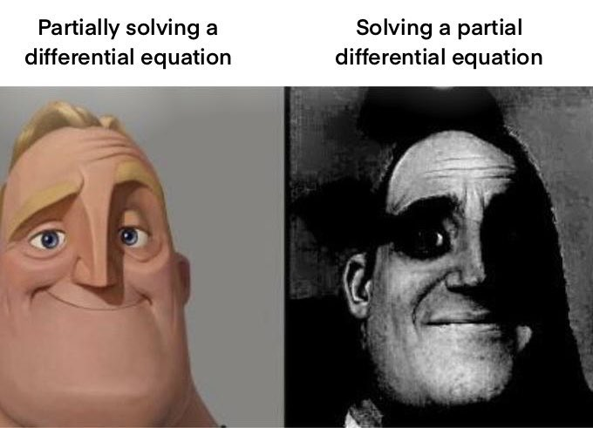
Key Takeaways!
When simplifying equations, consider natural variables to remove pesky terms!
  Partial derivatives are your friend
  Lecture T10, slide 5 will be your BFF
Remember what assumptions you make (i.e. constant T, V, P)
Equations of state are typically based in Helmholtz Energy, A

